Slide 1
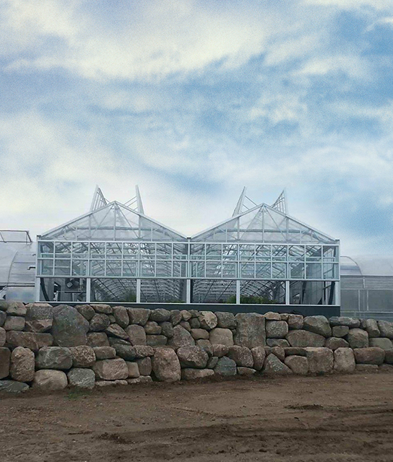

Cast 2025
Review & New Variety HIGHLIGHTS

Slide 2
perennials

Slide 3

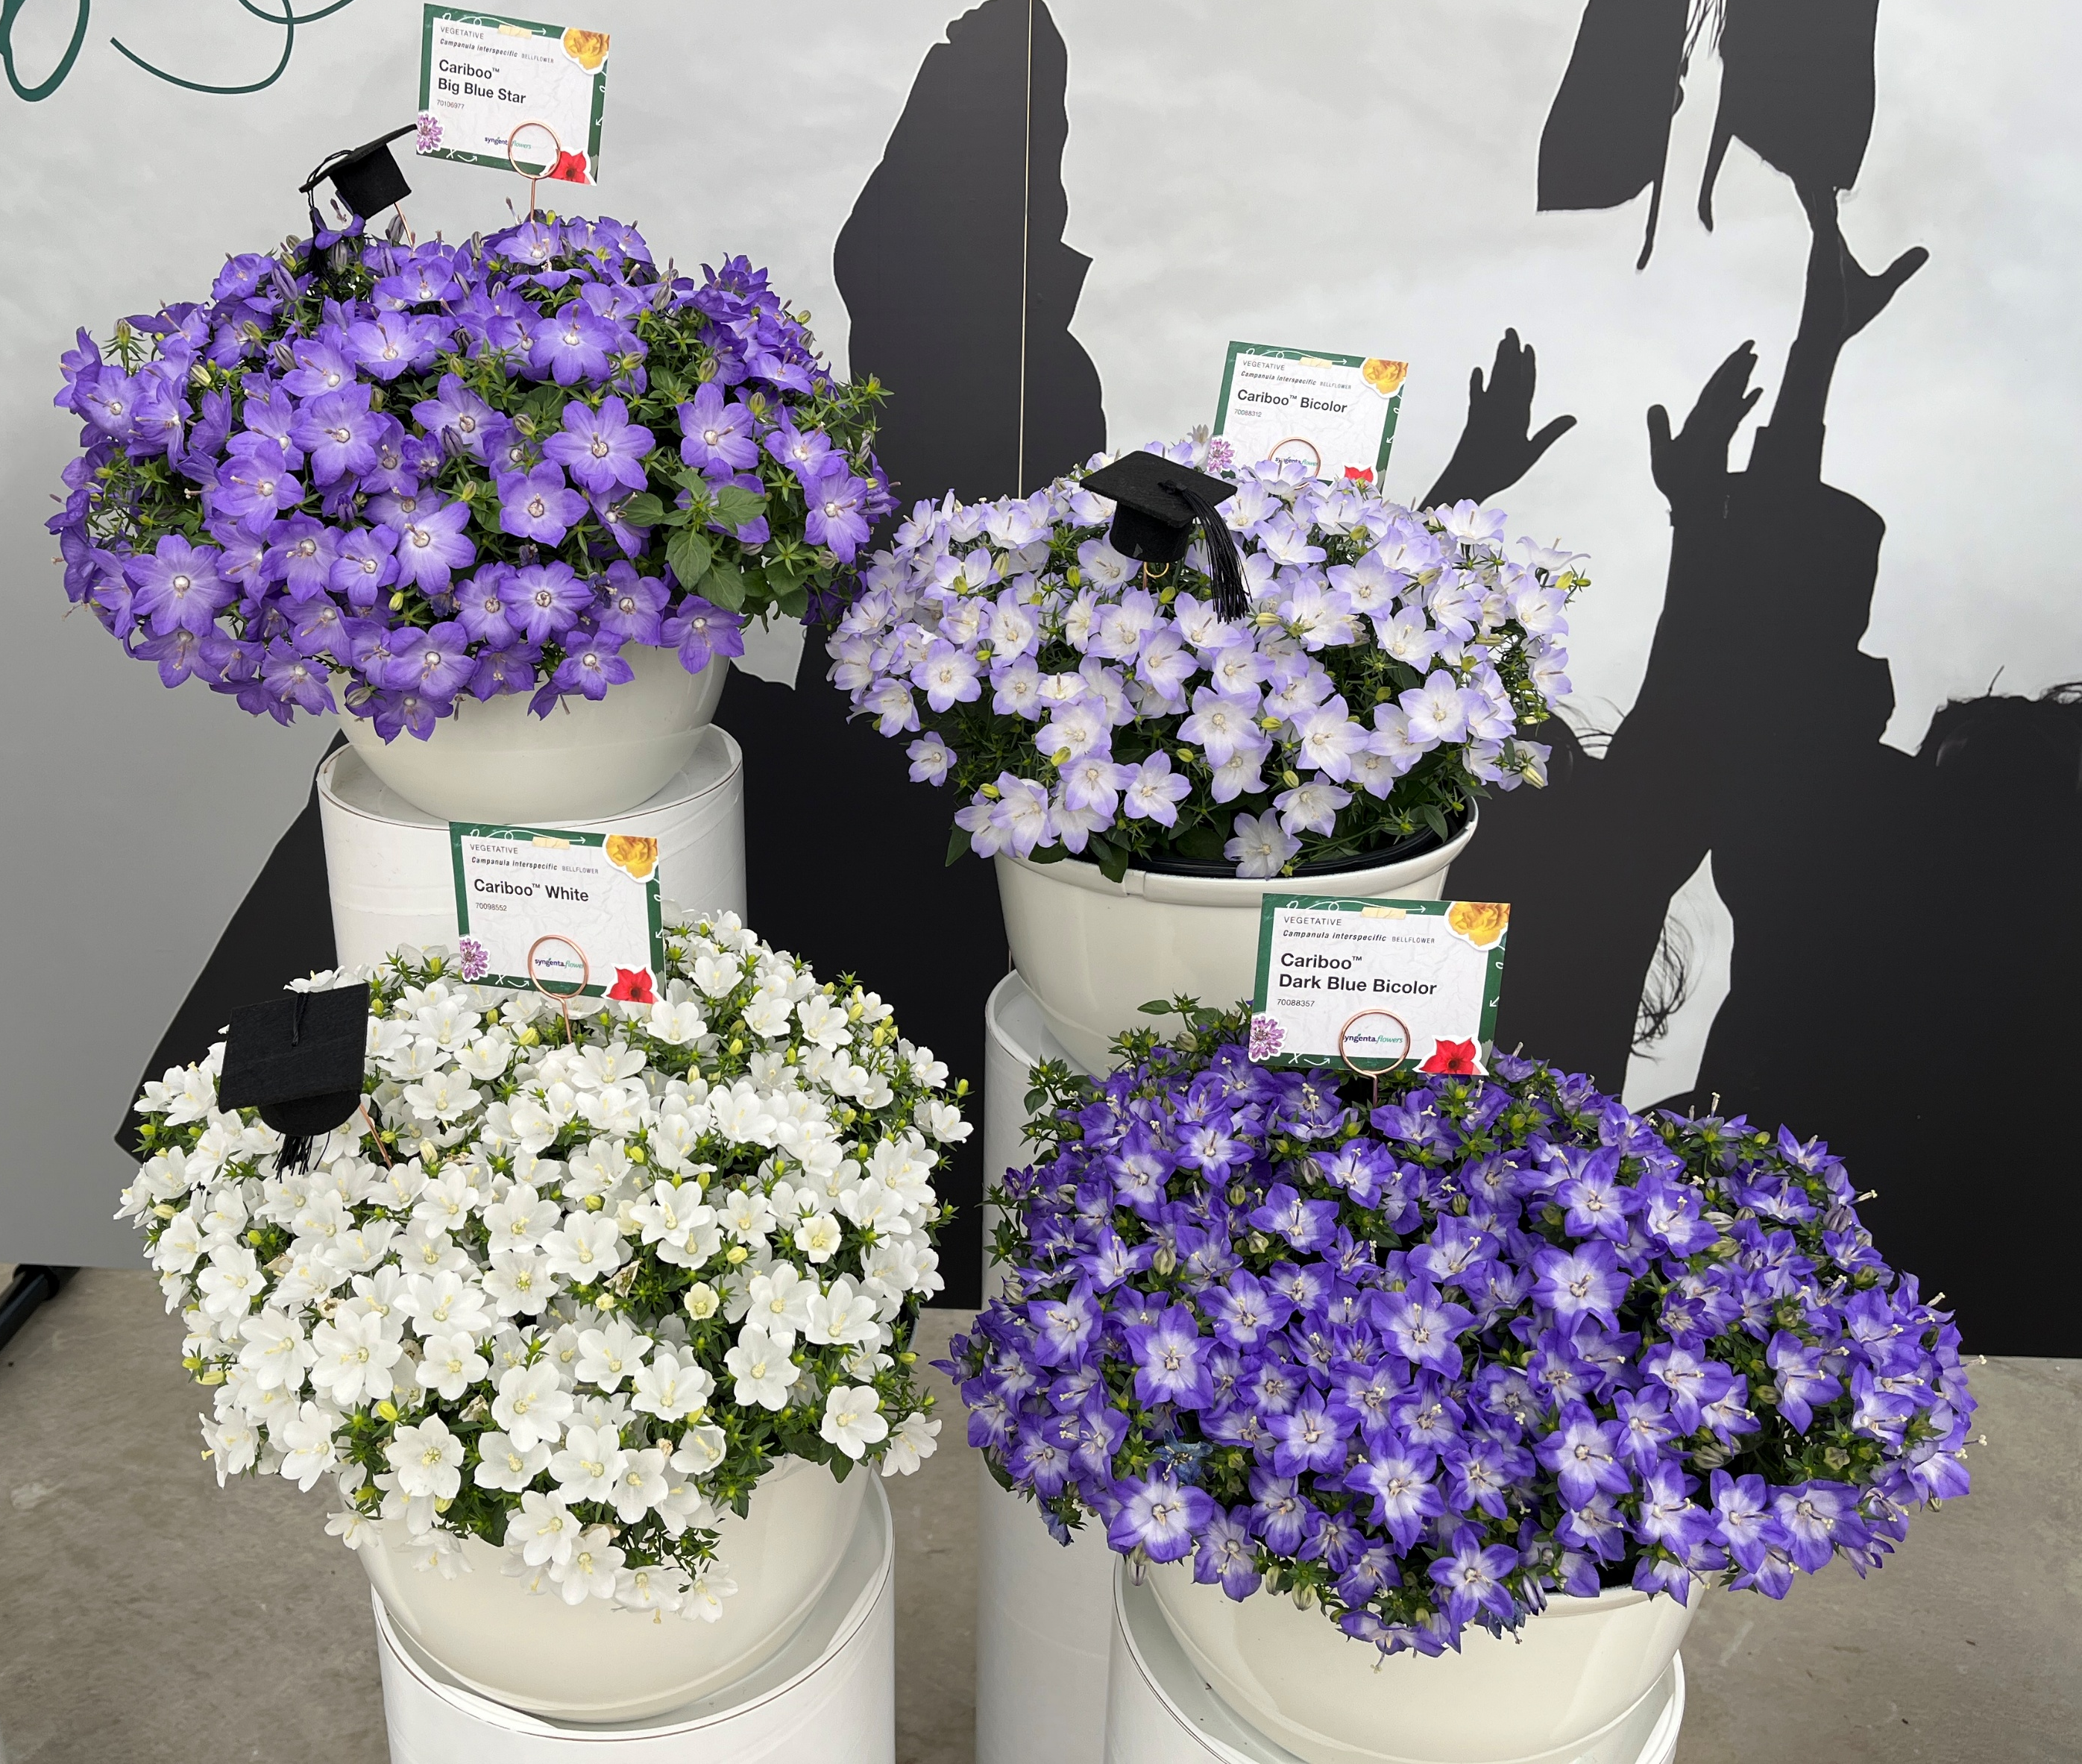
Campanula Interspecific Cariboo™
Flowers earlier and stronger than other interspecific varieties
Strong upright mounding habit
4 colors – Big Blue Star, Bicolor, White and Dark Blue Bicolor
Cariboo Big Blue Star is an upgrade to Cariboo Forte Blue offering improved vigor
Exposure Full Sun
Flowering Mid Spring - Summer
Zone 5-9
Vernalization not required
Pot Sizes 1 qt, 1.25 qt 2.5 qt
Offered as URC, CC

Slide 4
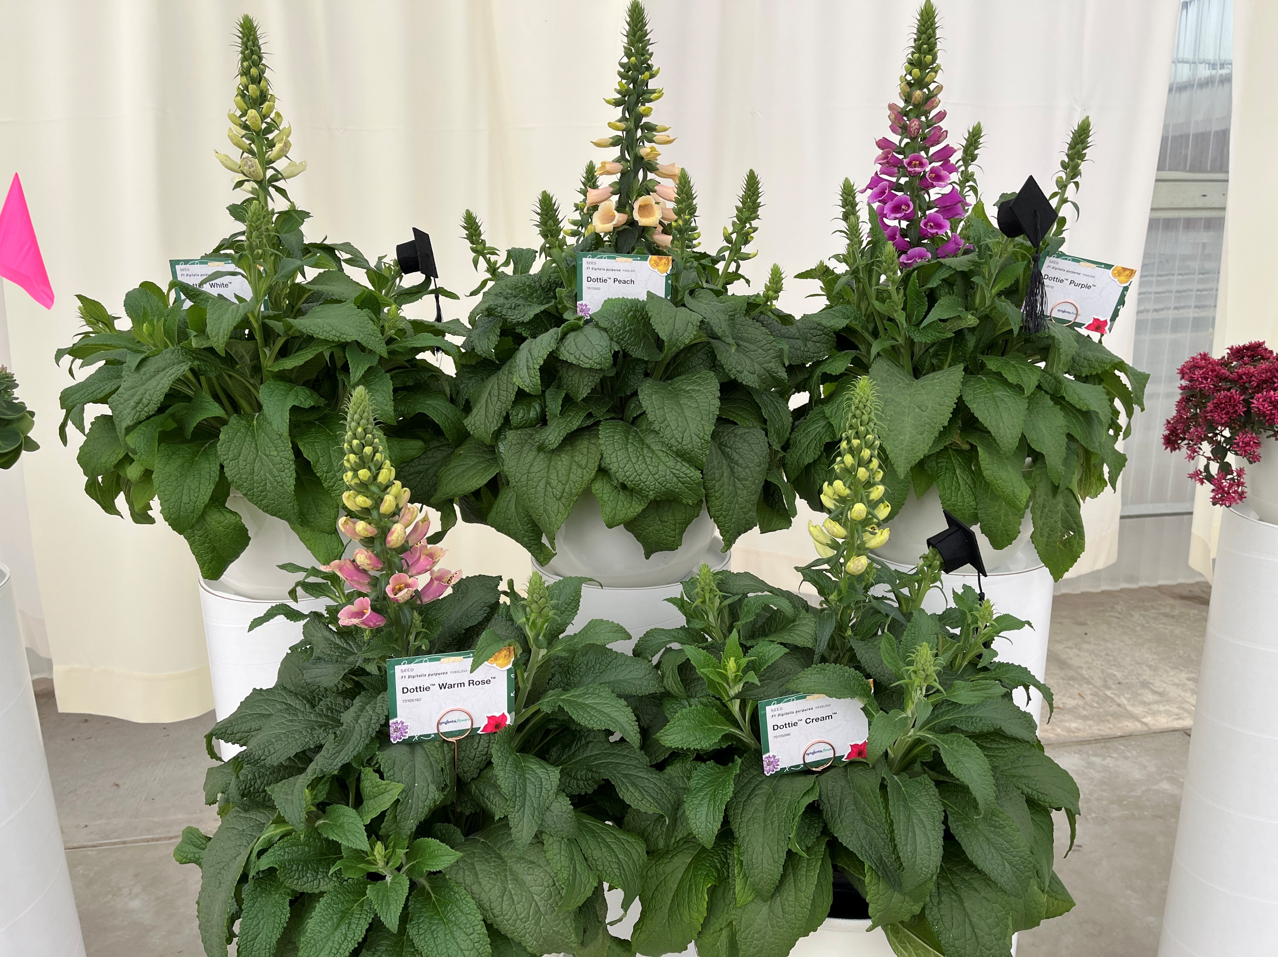
Digitalis purpurea F1 Dottie™
Compact, well branched plants are easier to finish in a variety of sizes , requiring less PGR’s
30% more compact than Camelot
Uniform and early to flower with an upright habit
5 colors White, Peach, Purple, Warm Rose and Cream
Exposure Part Shade - Full Sun
Flowering Early Spring - Winter
Zone 4-9
Vernalization not required
Pot Sizes 2.5 qt 3 qt
Available as pelleted seed

Slide 5
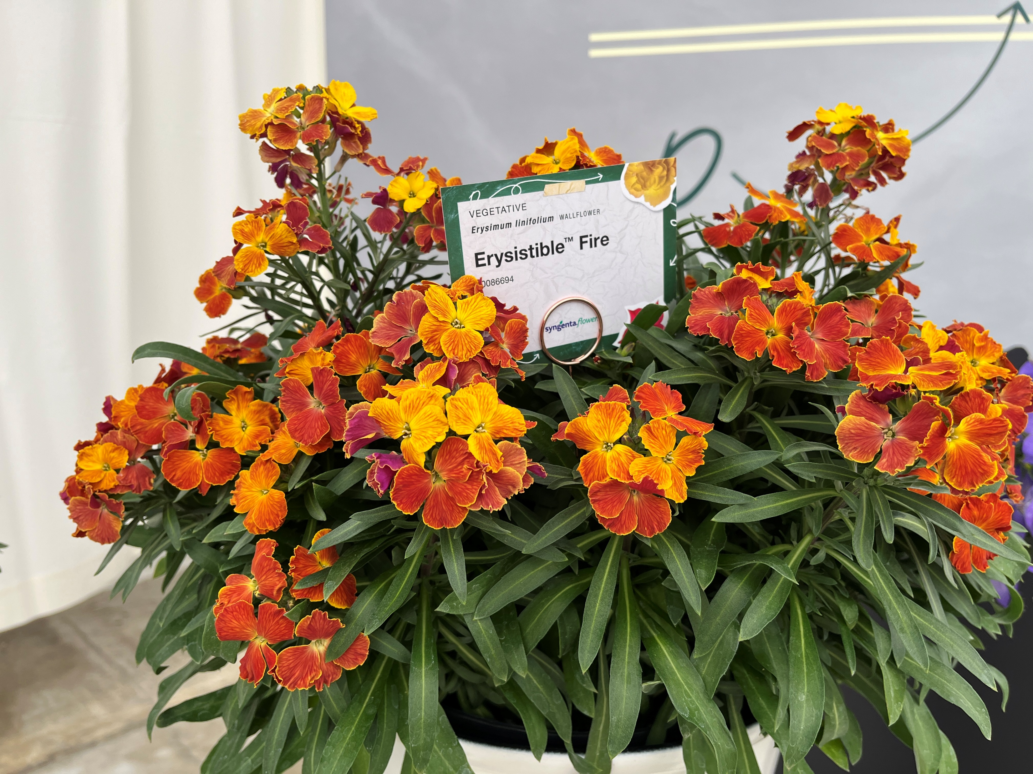
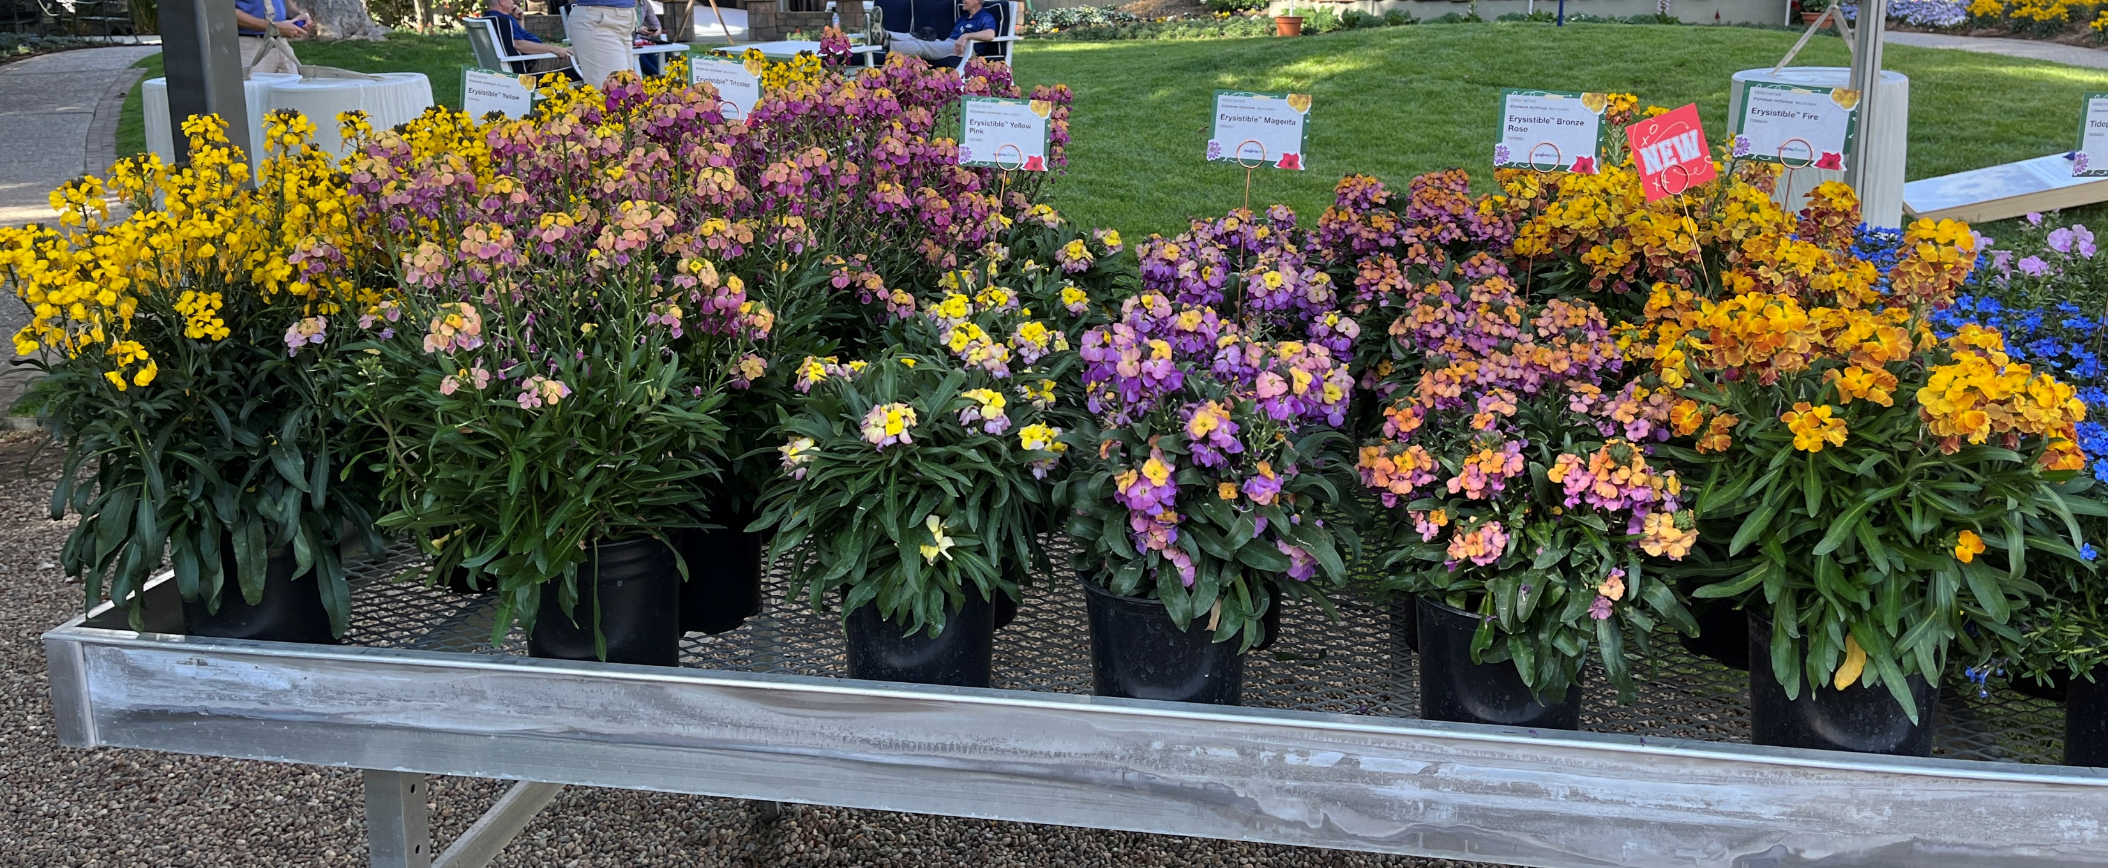
Erysimum linifolium Erysistible™ Fire
The first Zone 5 hardy series of Erysimum
Available in a variety of novelty colors
Medium-vigor controlled upright habit
Exposure Full Sun
Flowering Early Spring – Late Spring
Zone 5-9
Benefits from Vernalization
Pot Sizes 1 qt 2.5 qt
Available as URC

Slide 6
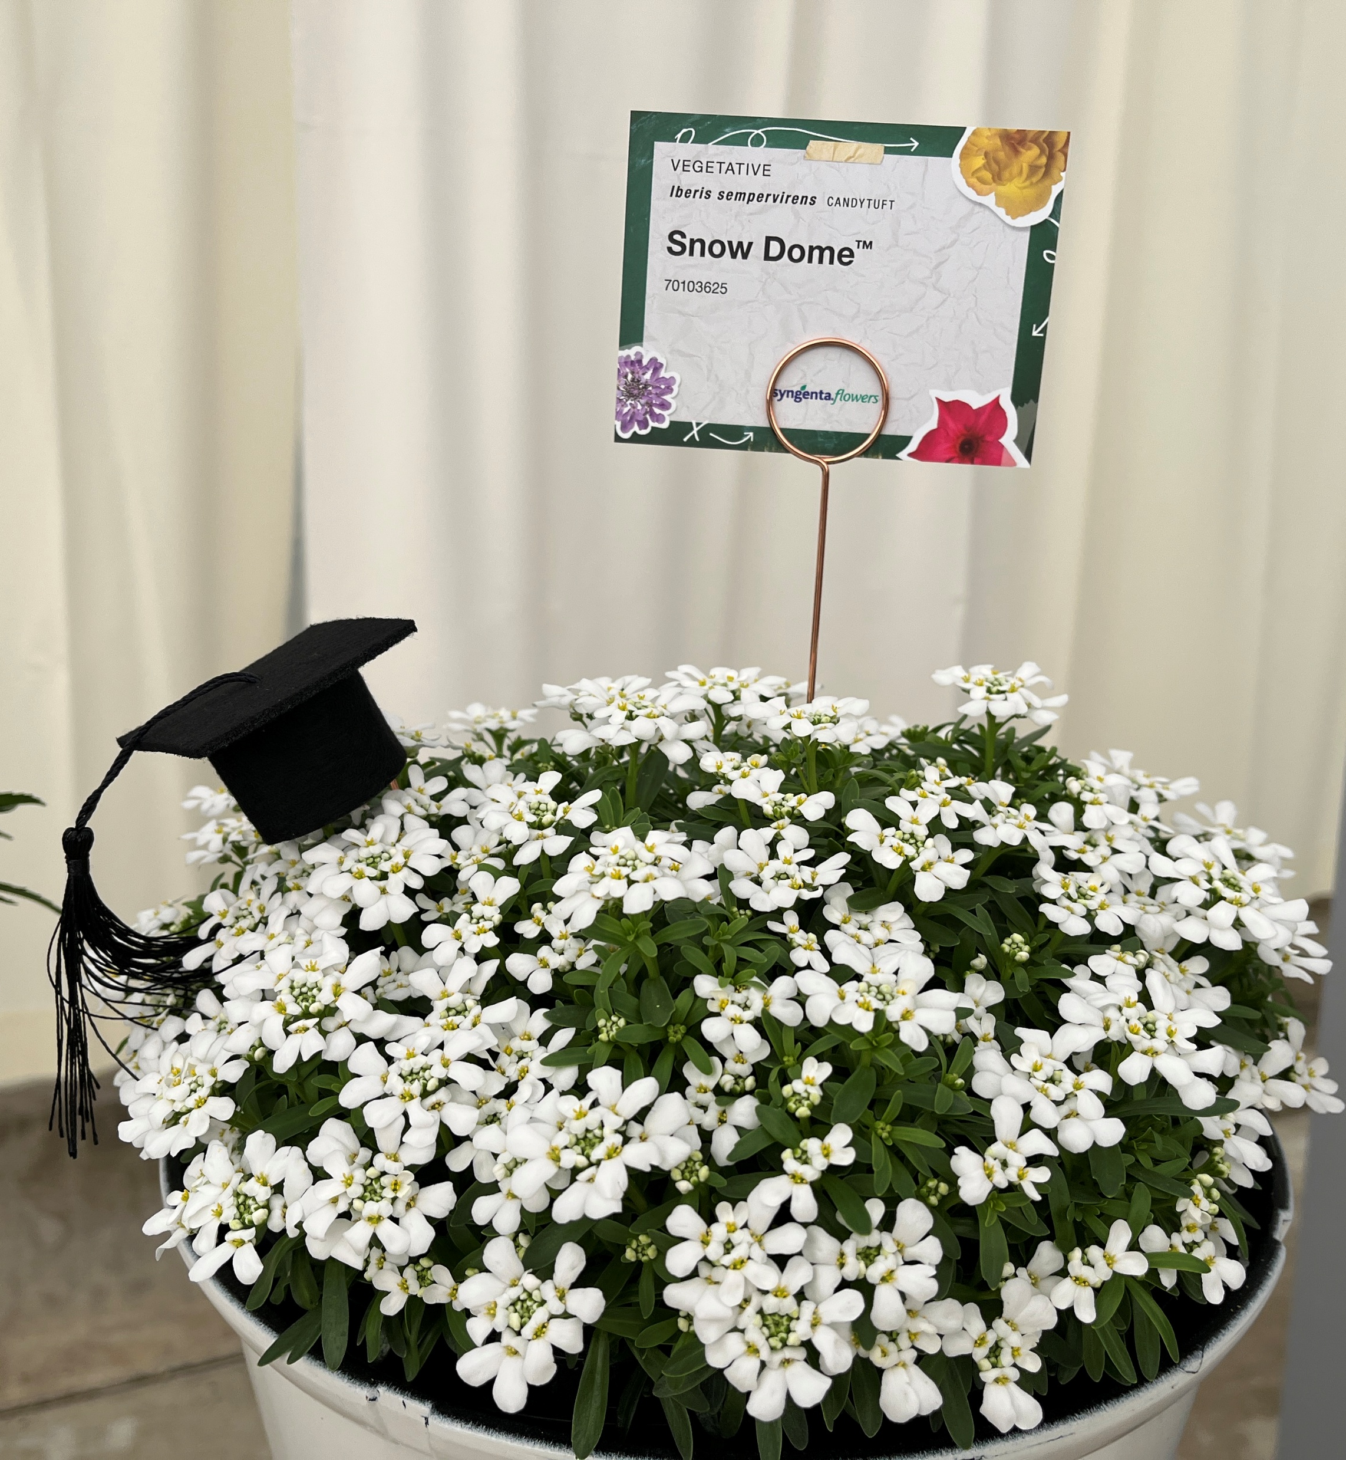
Iberis sempervirens Snow Dome™
Extra large white snowy flowers on sturdy well branched plants
Timing is later than Snowsurfer Forte and has long lasting flowers
Bred for easier and more efficient propagation
Exposure Part shade - Full Sun
Flowering Early Spring – Late Spring
Zone 4-9
Vernalization required
Pot Sizes 1 qt, 1.25 qt
Offered as URC, CC

Slide 7
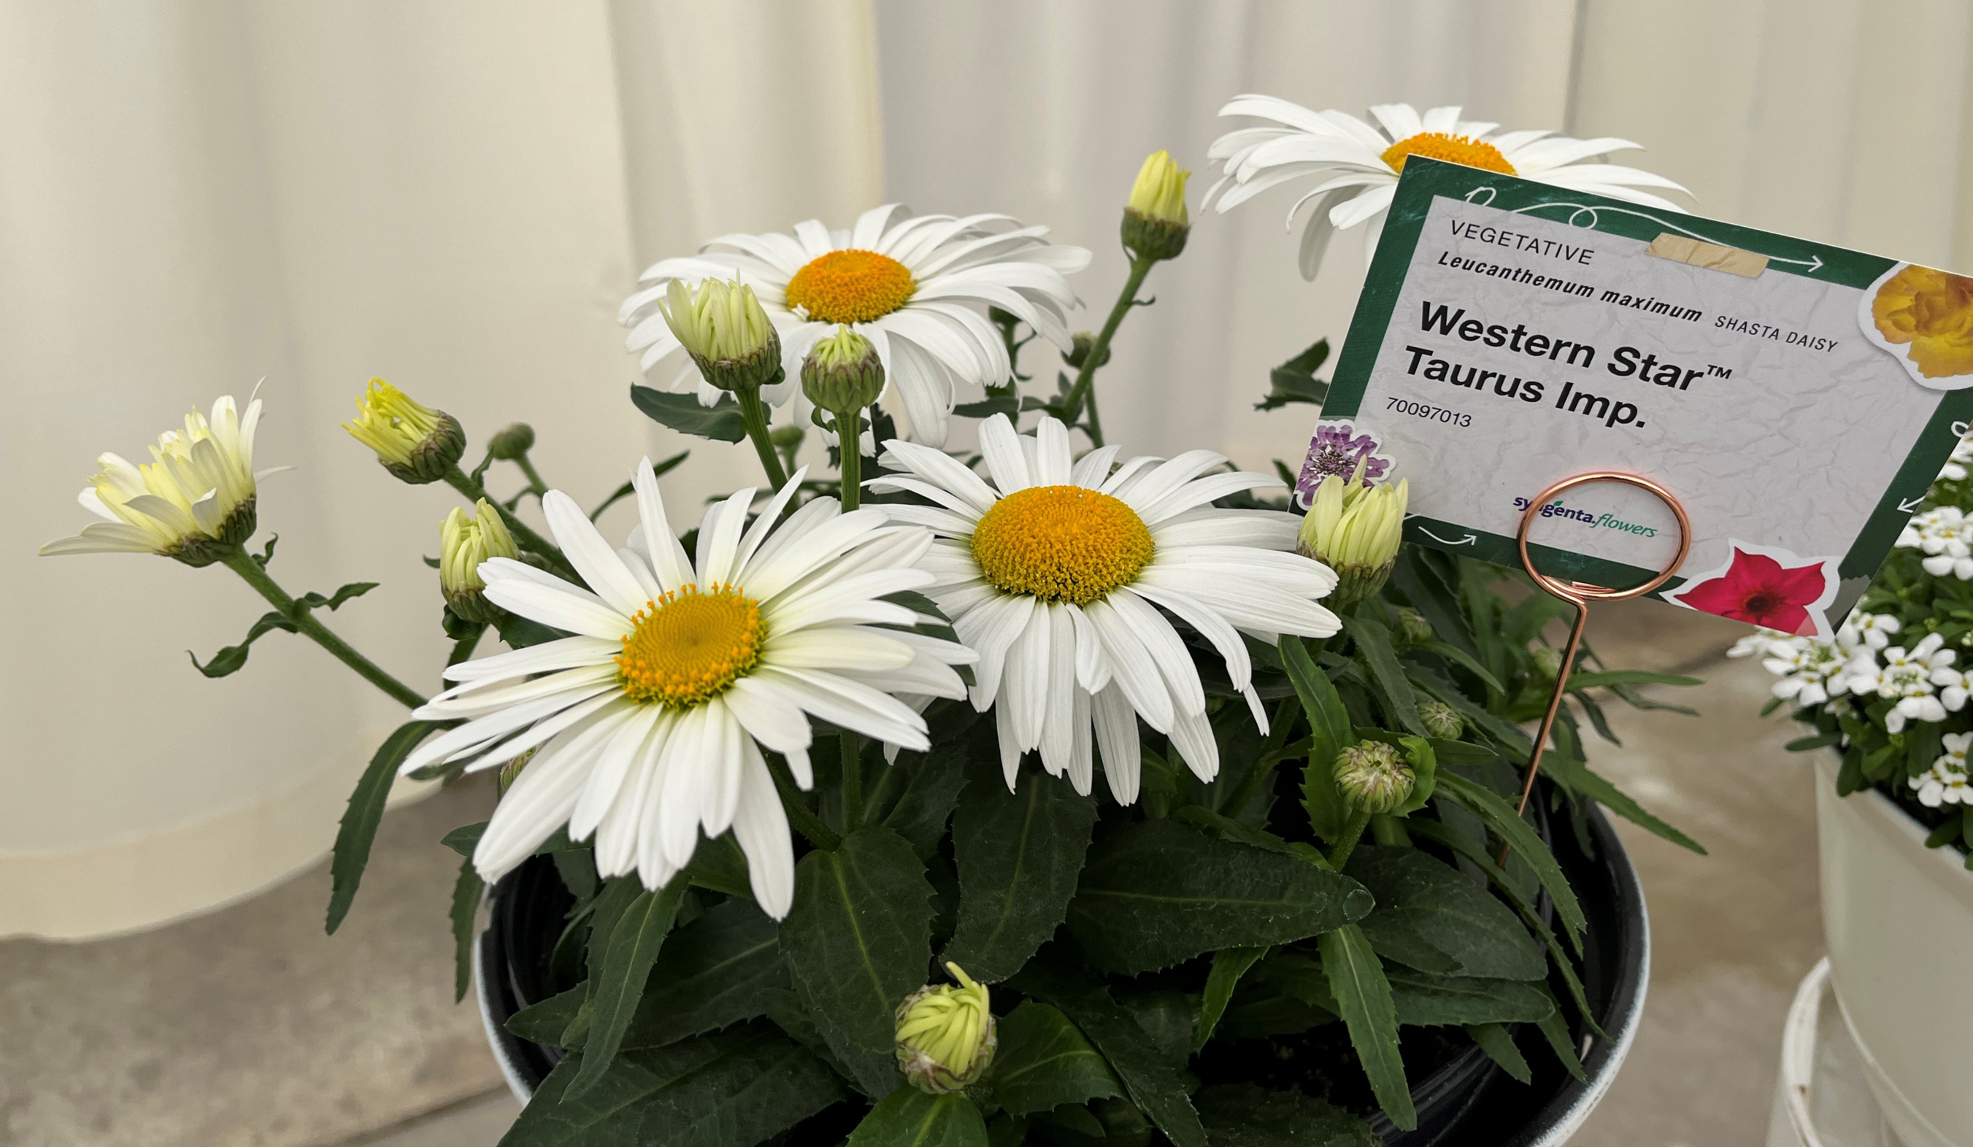
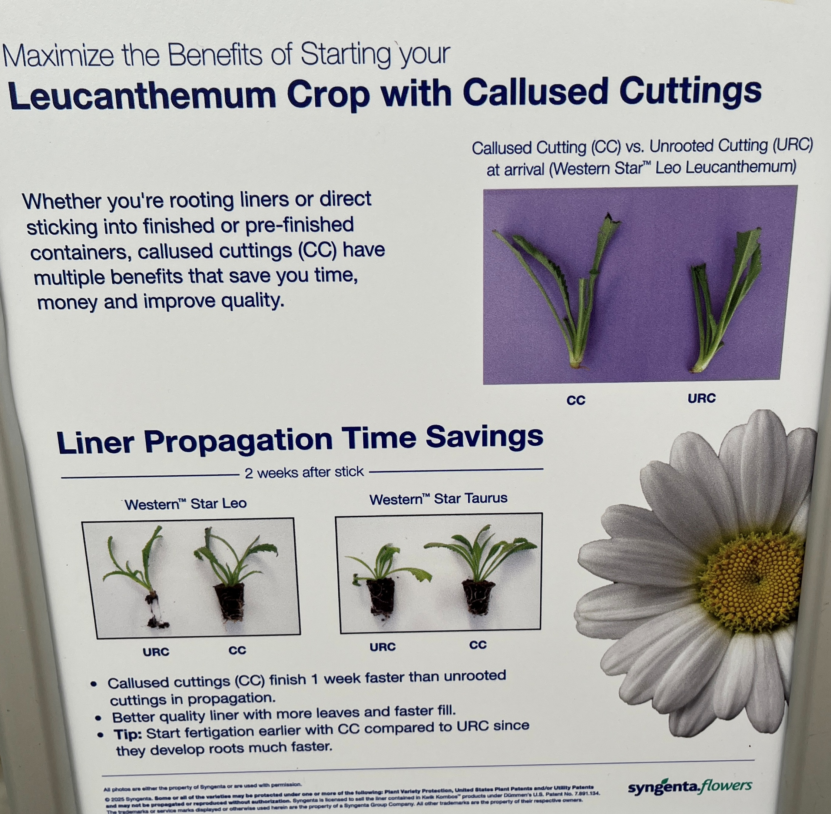
Leucanthemum maximum Western Star™
New Western Star Capricorn (yellow) and improved Taurus
All varieties have low chilling requirements to ensure consistent blooming
Callused cuttings offer a reduced crop time and a better quality liner
Upright habit
Exposure Full Sun
Flowering Mid Spring - Summer
Zone 4-9
Vernalization beneficial
Pot Sizes 1 qt – 2.5 gal
Offered as URC, CC

Slide 8
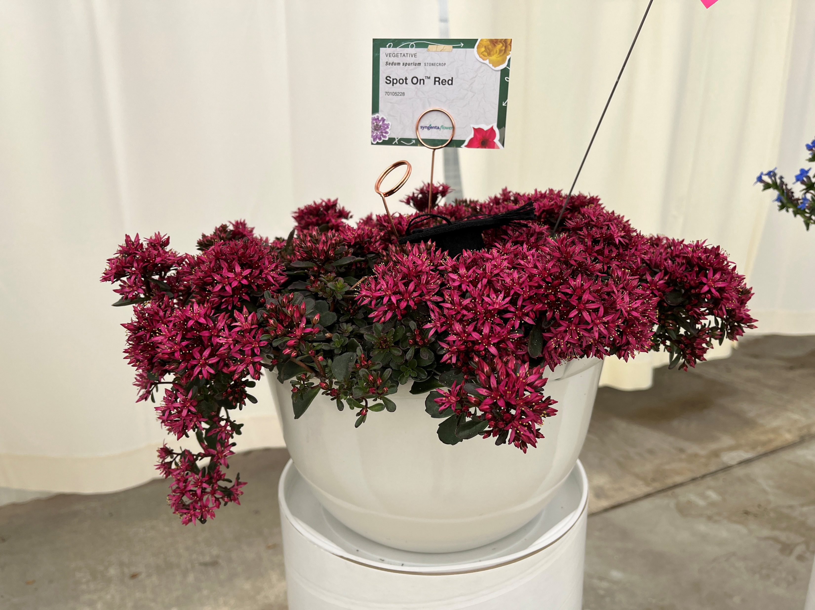
Sedum spurium Spot on™ Red
Attractive foliage and bright red flowers and buds
Low growing groundcover with a spreading habit
First year flowering makes scheduling and production easy
Exposure Full Sun
Flowering Mid Spring - Fall
Zone 4-9
Vernalization not required
Pot Sizes 1 qt – 2.5 qt
Offered as URC, CC

Slide 9

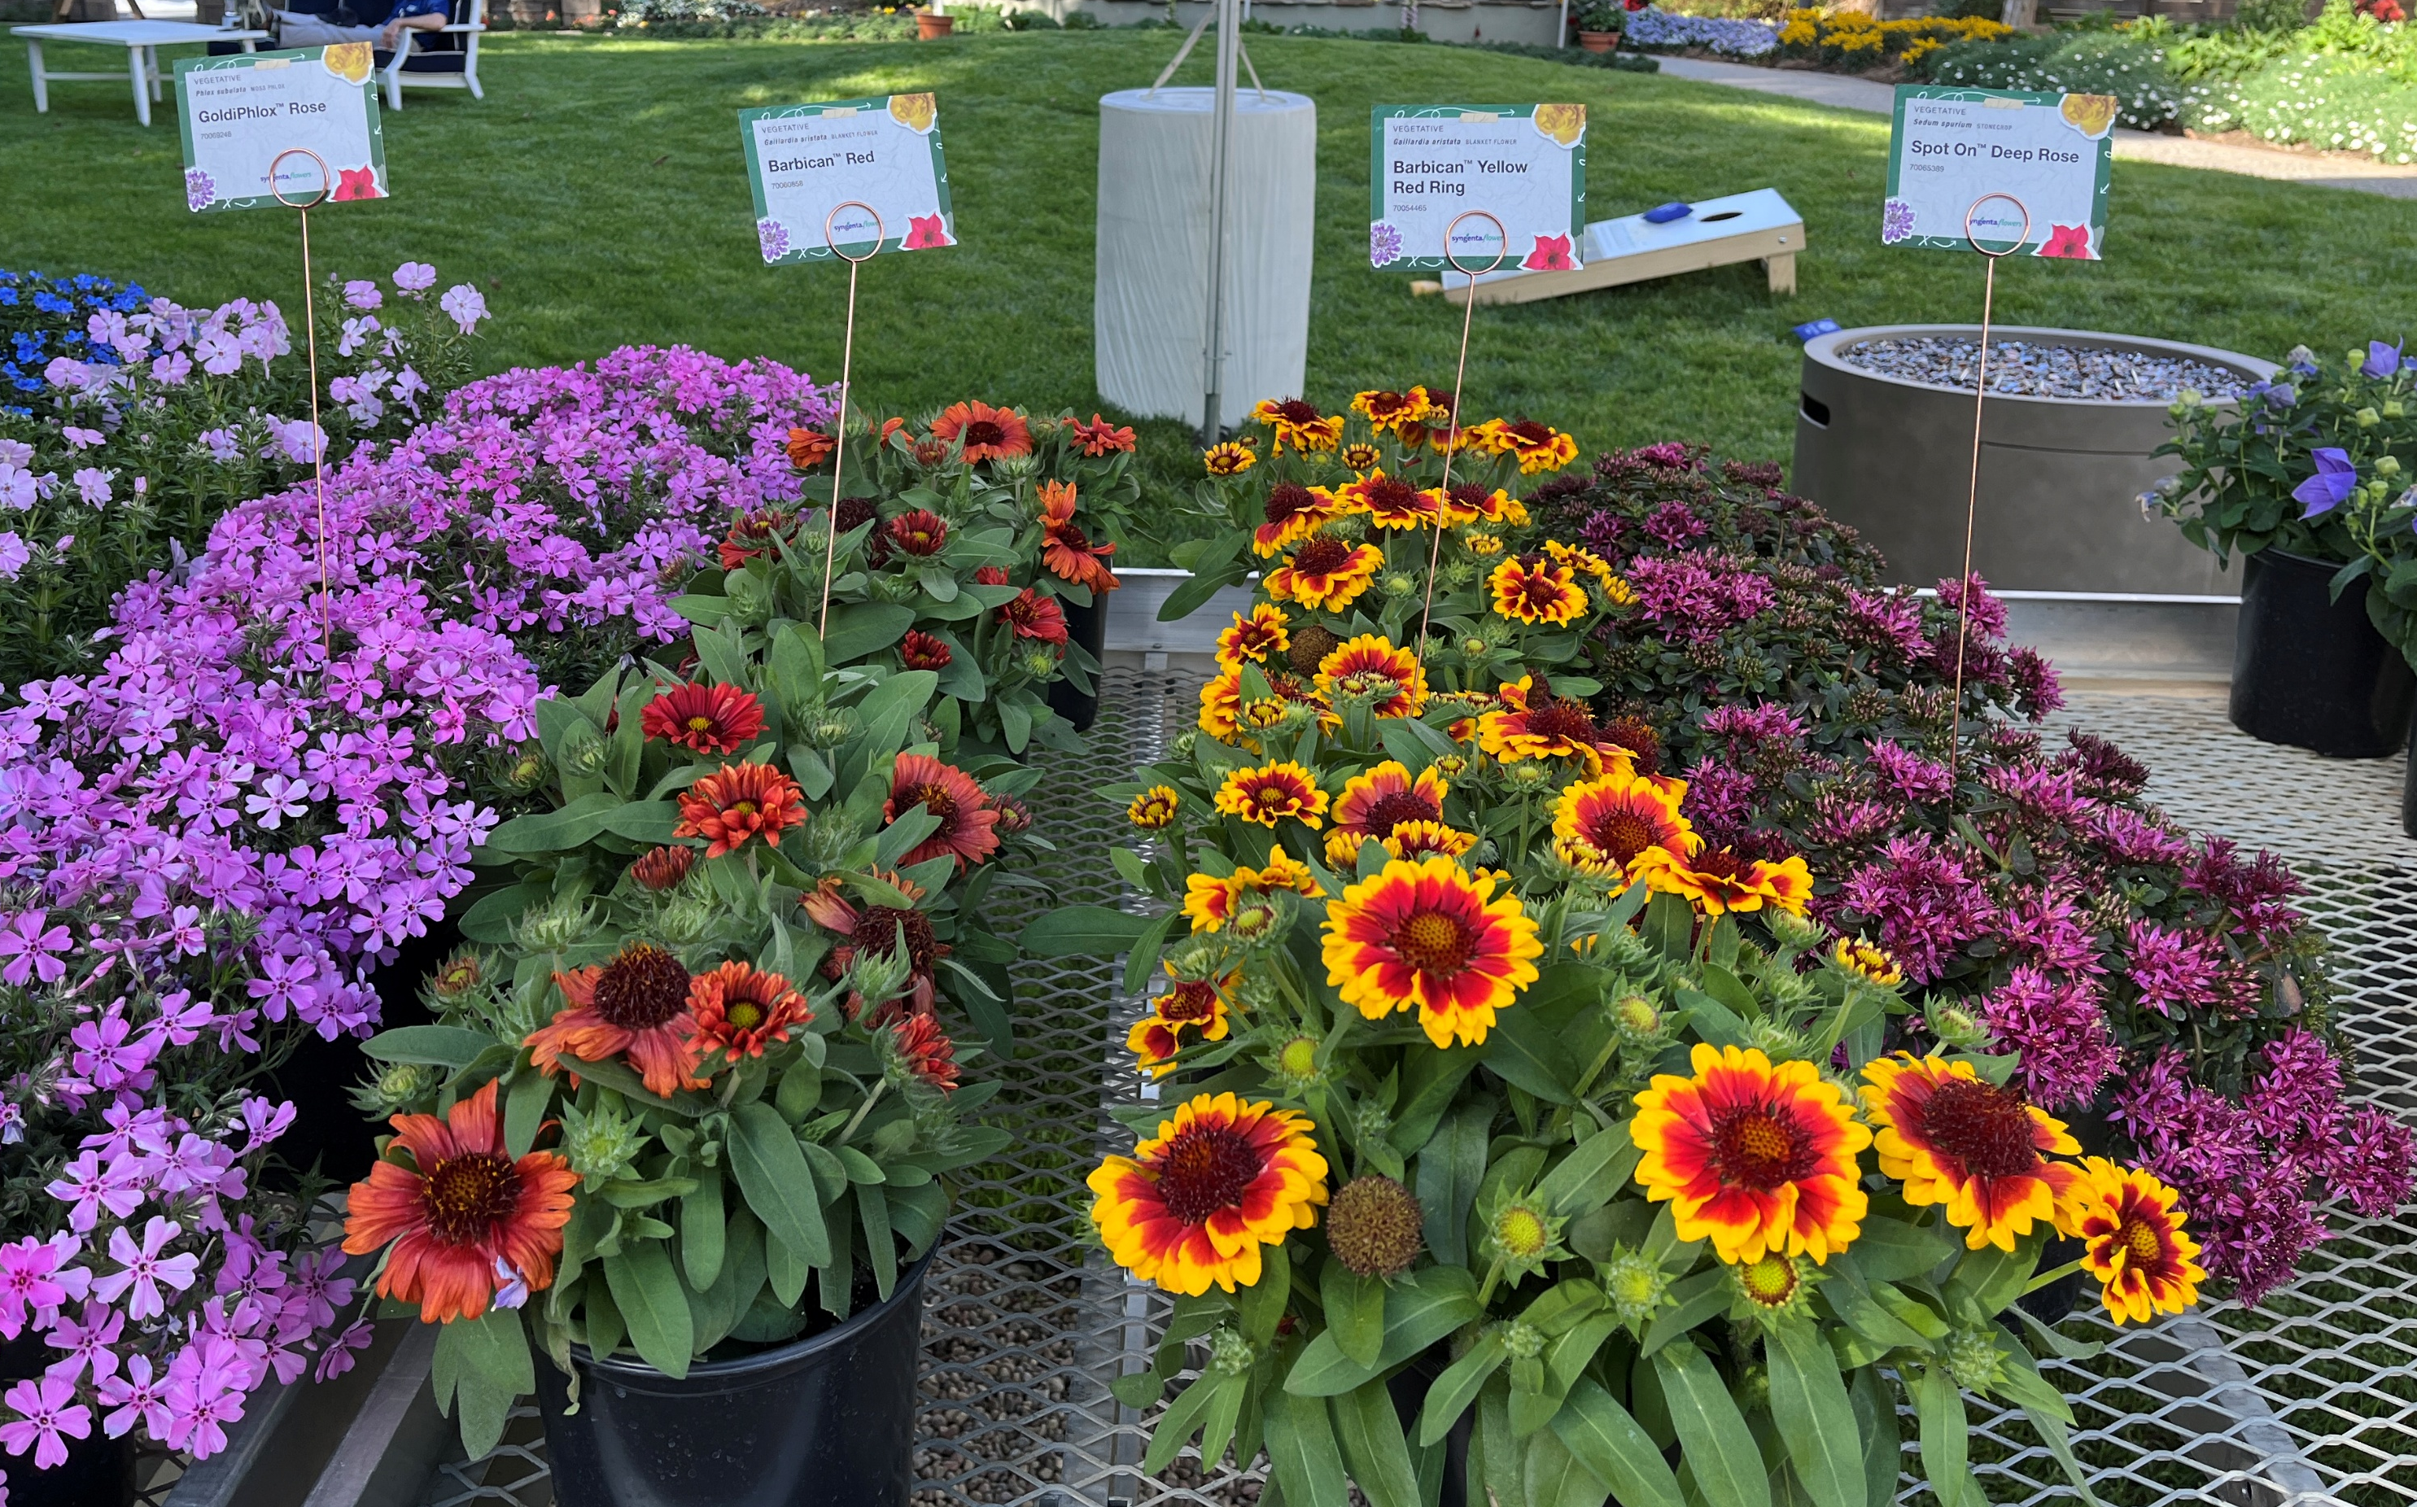
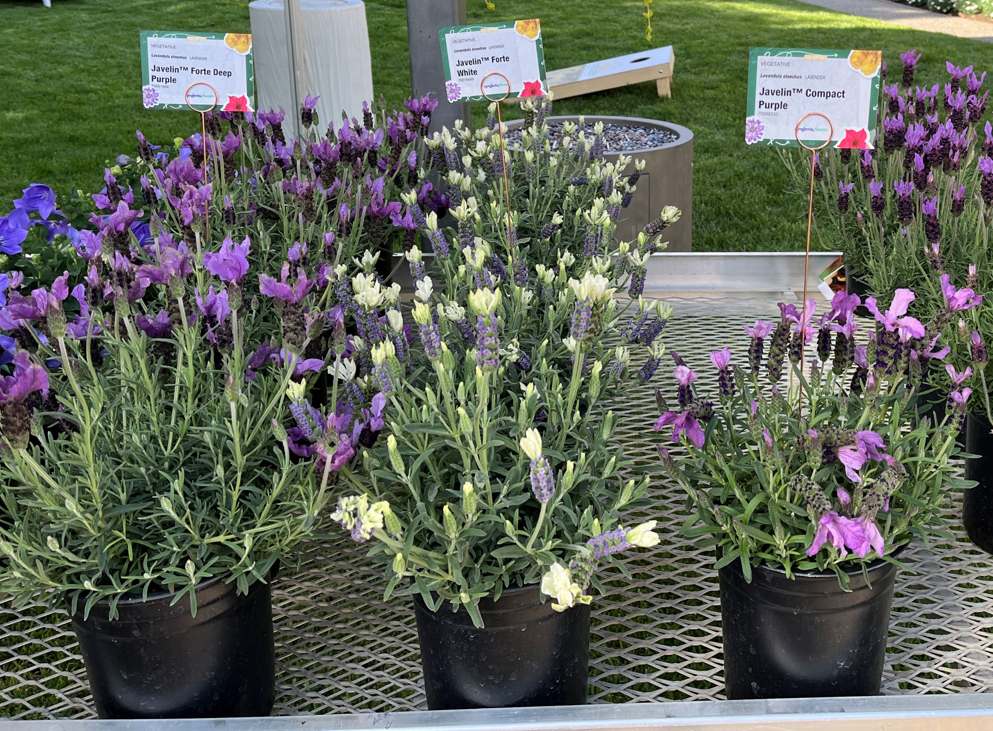
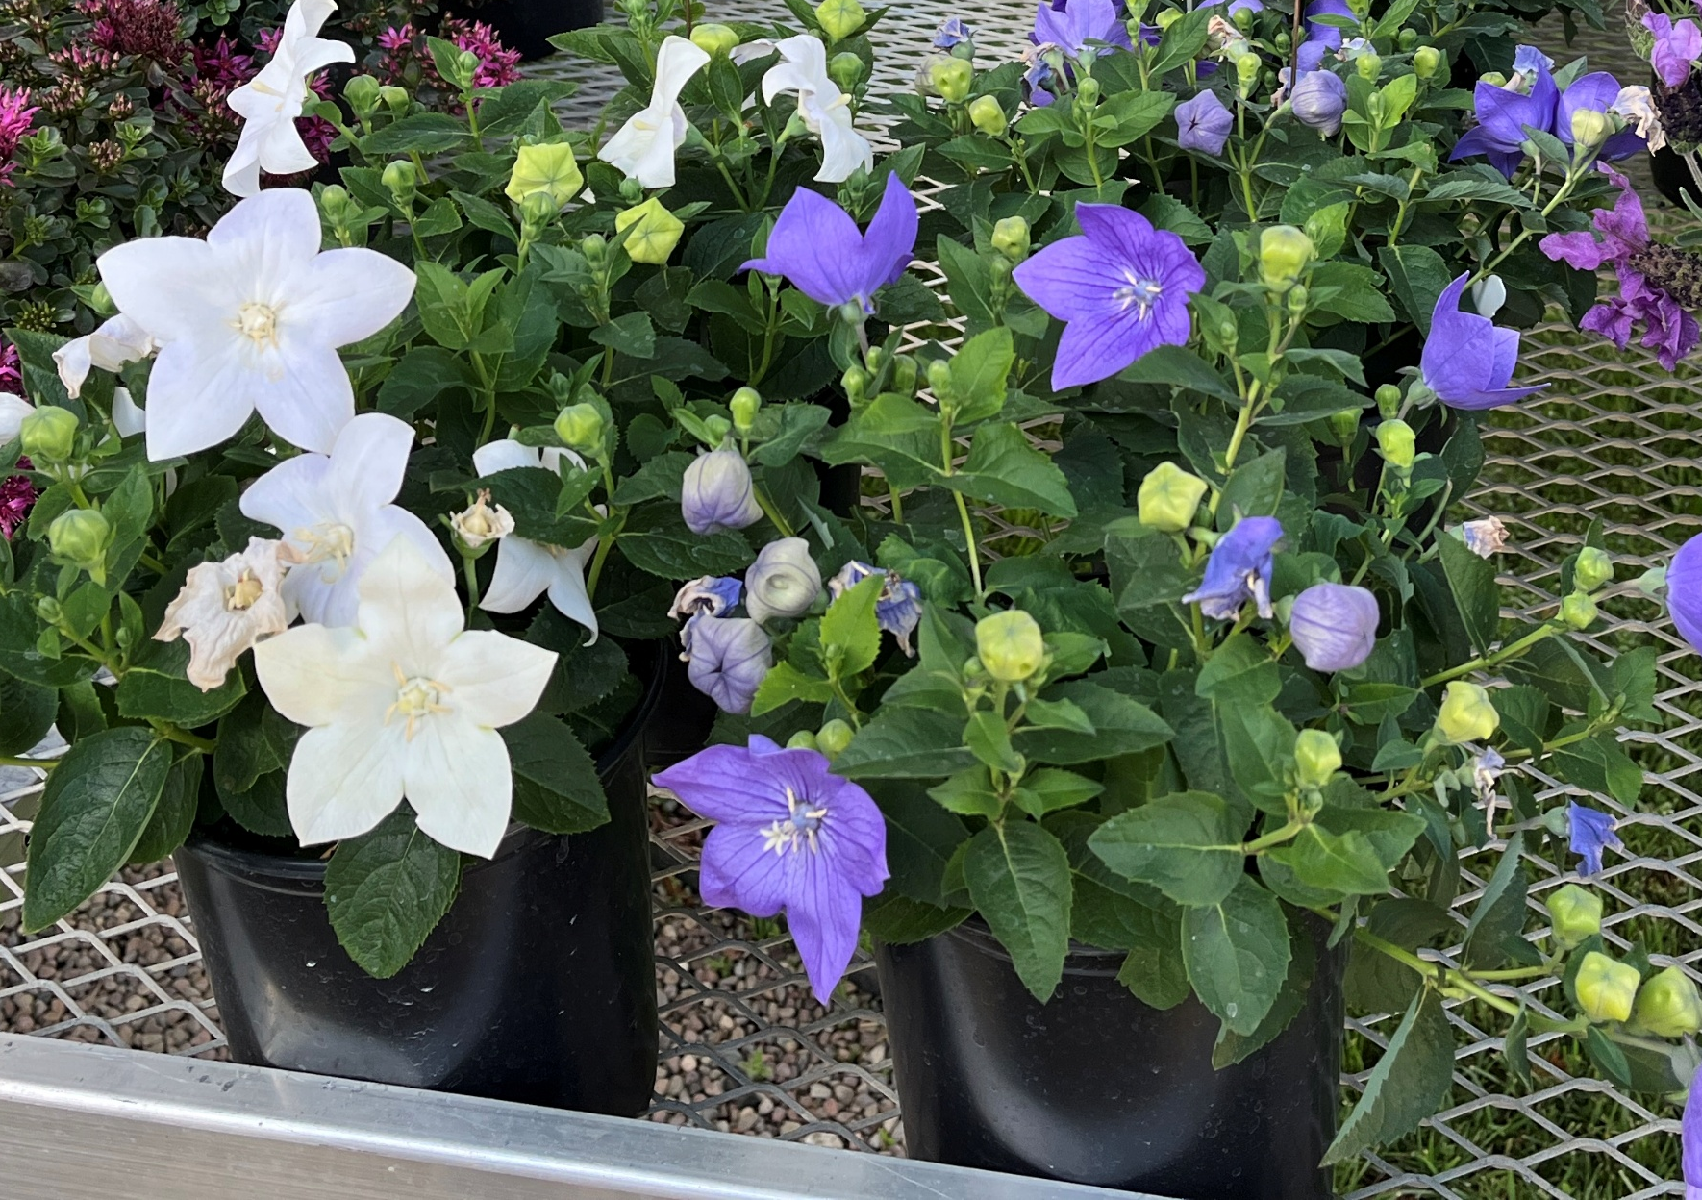
Solid performing existing perennials
Phlox subulata Goldiphlox (veg) – can use just 1 ppp vs older genetics than need 2. Zone 3a – 9b, 7 colors.
Gaillardia Barbican™ (veg) – multiflora Gaillardia. Zone 4a-9b, 6 colors, vernalization not required
Spanish Lavender – Javelin™ Forte (veg) zone 7a-9b, Deep Purple, Deep Rose and white. Offers exceptional disease tolerance
Platycodon Twinkle™ (seed), blue or white, 1st year flowering. Zone 3a – 8b.

Slide 10

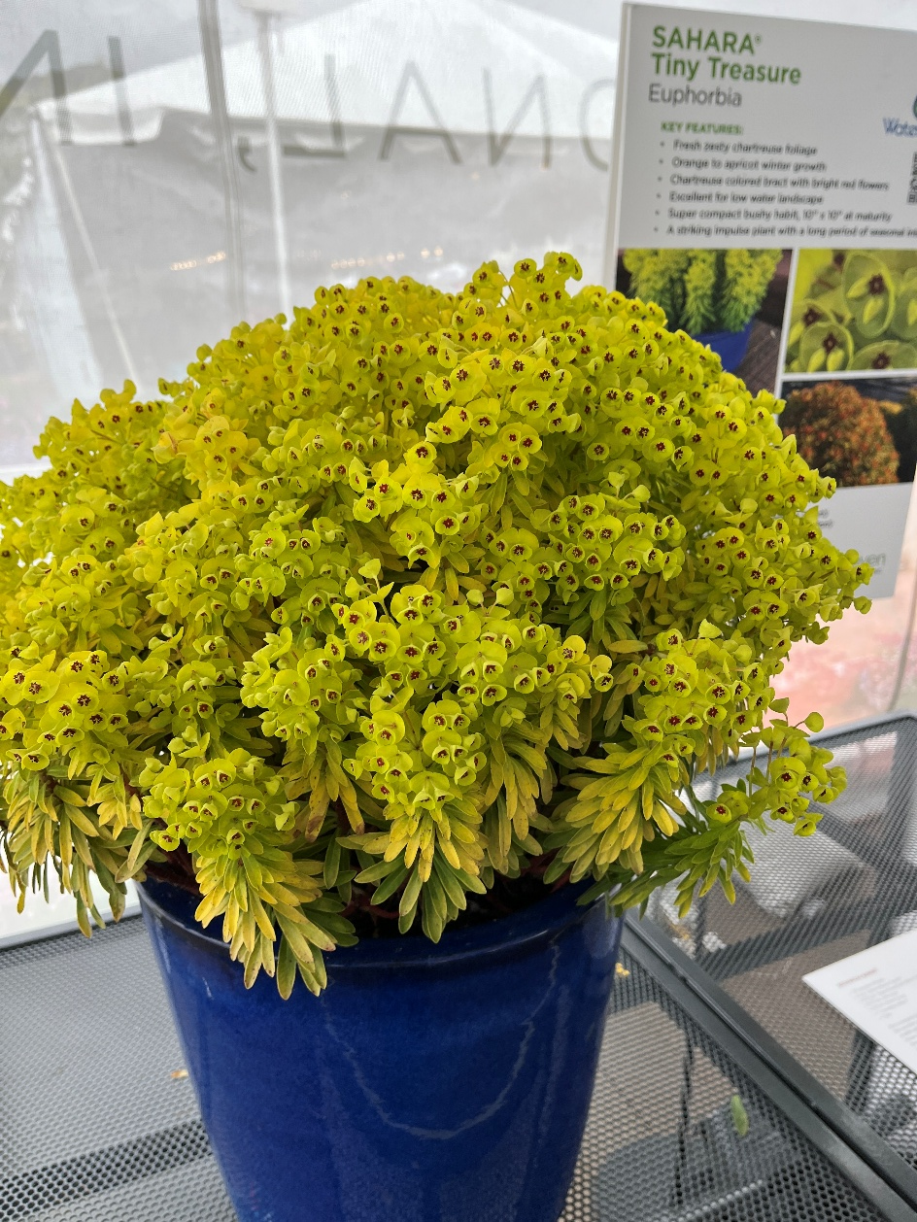
Euphorbia Sahara™ Tiny Treasure
Long season of interest
Bright yellow foliage has an apricot coloring in the Fall and on new growth
Flowers from spring to early summer
Low water use
Liners will be available at PP&L with limited availability this fall in 128 and 72’s
Hardy in zones 6-9
Height 12 – 18”

Slide 11

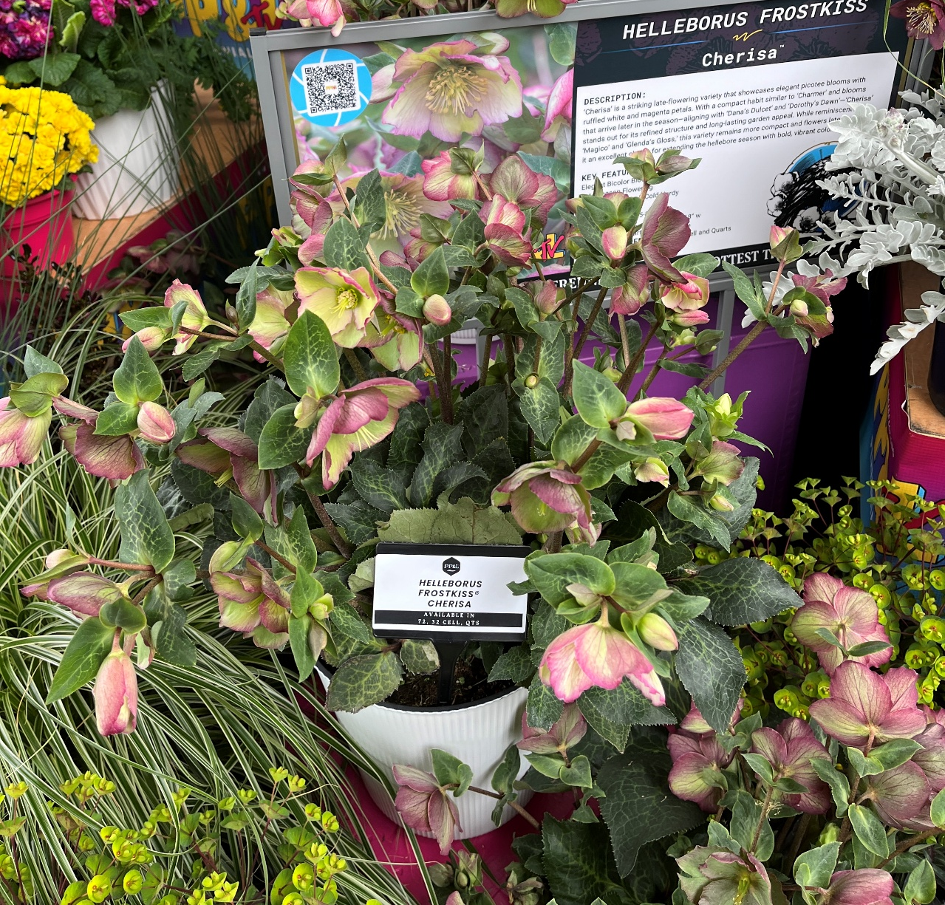
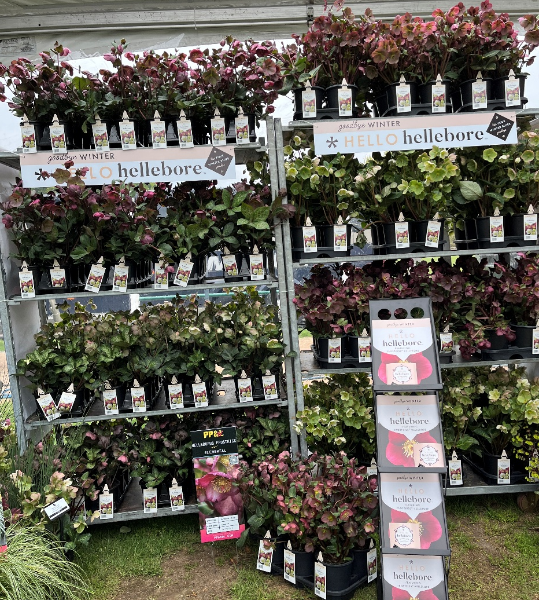
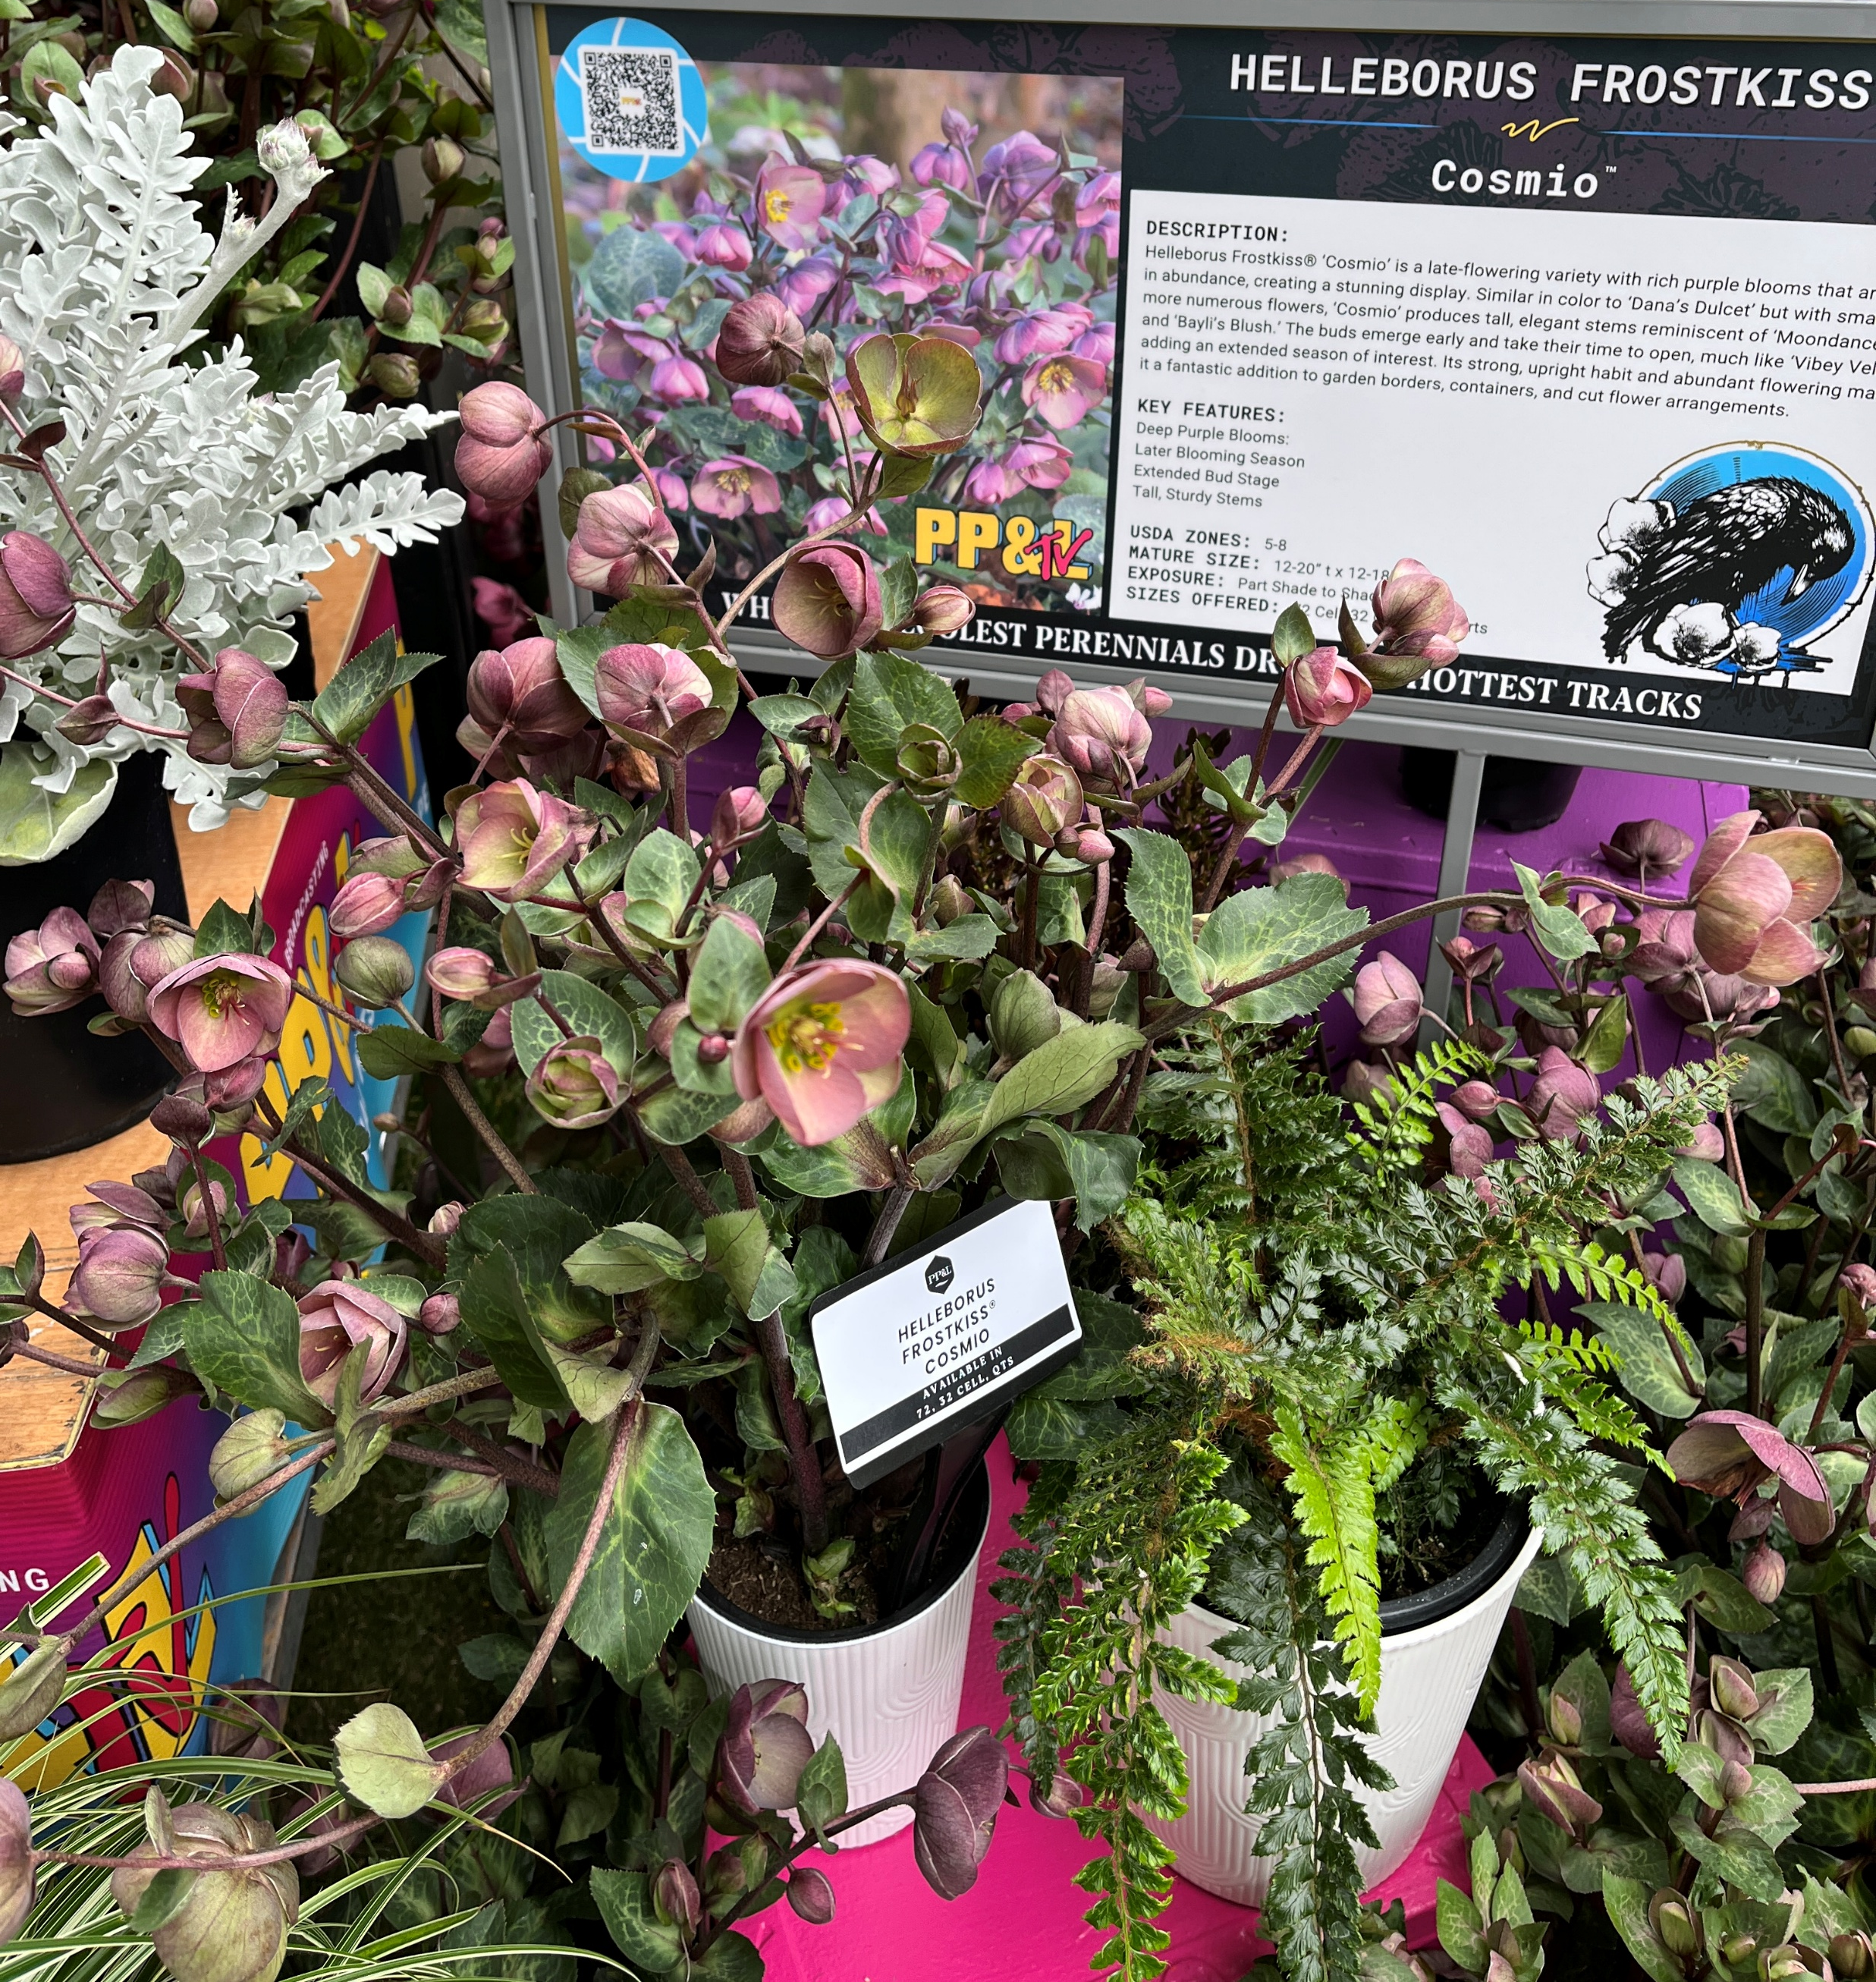
Hellebore
Frost Kiss™, 17 colors marbled foliage
New Cherisa is later flowering to extend the season, has picotee blooms with ruffled white and magenta petals
New Cosmio is a later season extending variety with tall stems, an upright habit and rich purple blooms. It is a good choice for cut flowers
pH and culture is very important – review tech guide
Prefinished quart program ships on wooden rack,
1 rack minimum (350 Quart pots)
Multiple varieties can be shipped per rack, with 1 variety per shelf (70 Quart pots)
Ships weeks 48 2025 – 15 2026

Slide 12
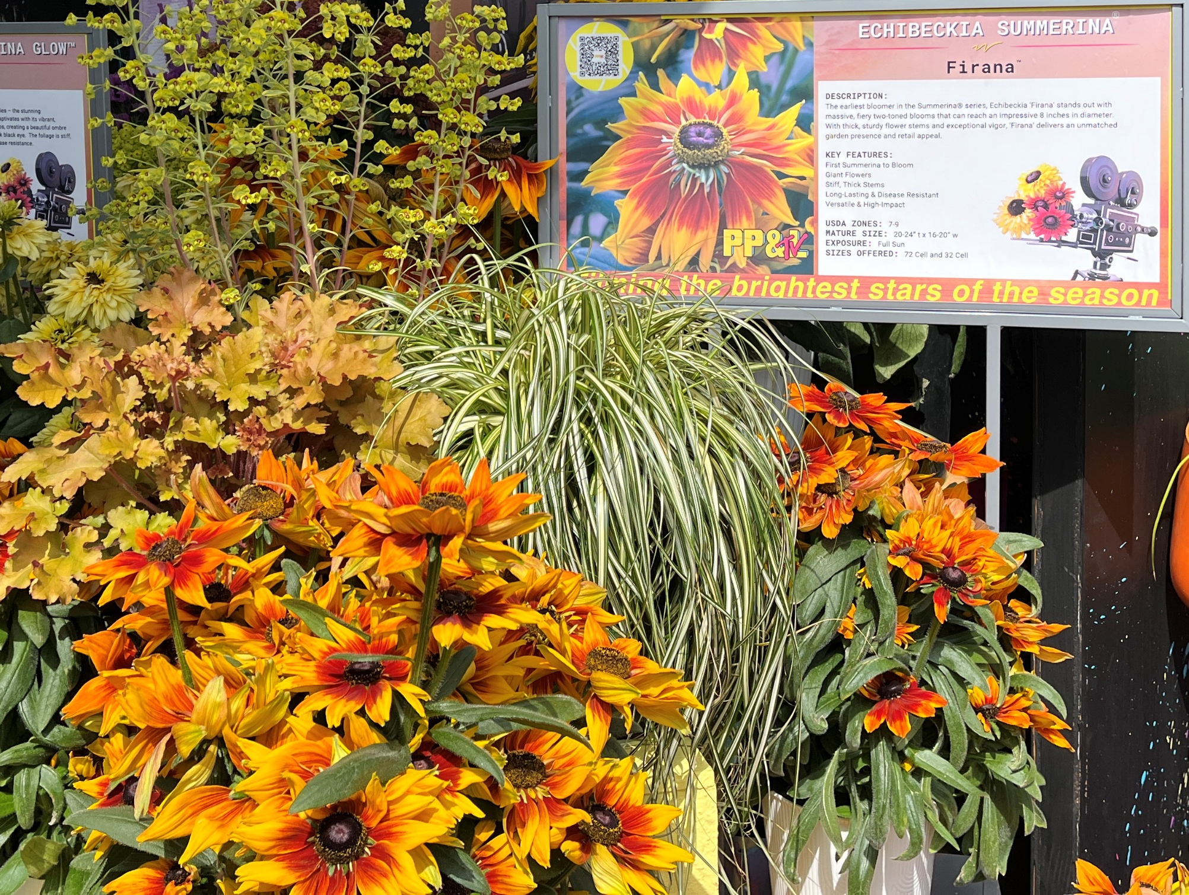
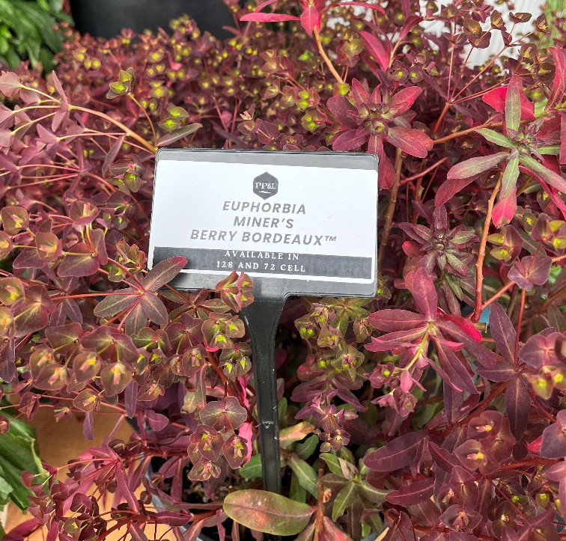
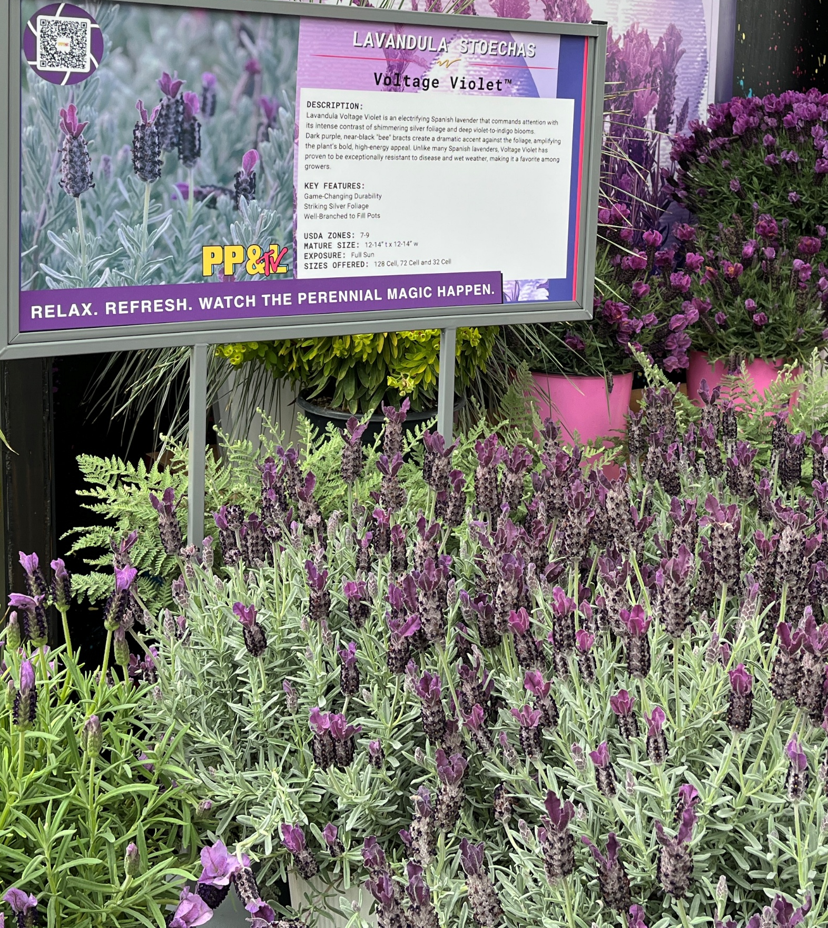
Other Notables…
Echibeckia Summerina® Firana
earliest blooming in the series with 8” fiery, two-toned flowers
Sturdy flower stems and exceptional vigor
Euphorbia Miner’s Berry Bordeaux™
Hardy to zones 4-9
Deep red burgundy foliage maintains it rich tones in full sun
Upright and mounding
Lavandula stoechas Voltage Violet™
Spanish type, hardy in landscapes zones 7-9
Silver foliage with deep violet to indigo blooms
Offers exceptional disease resistance

Slide 13

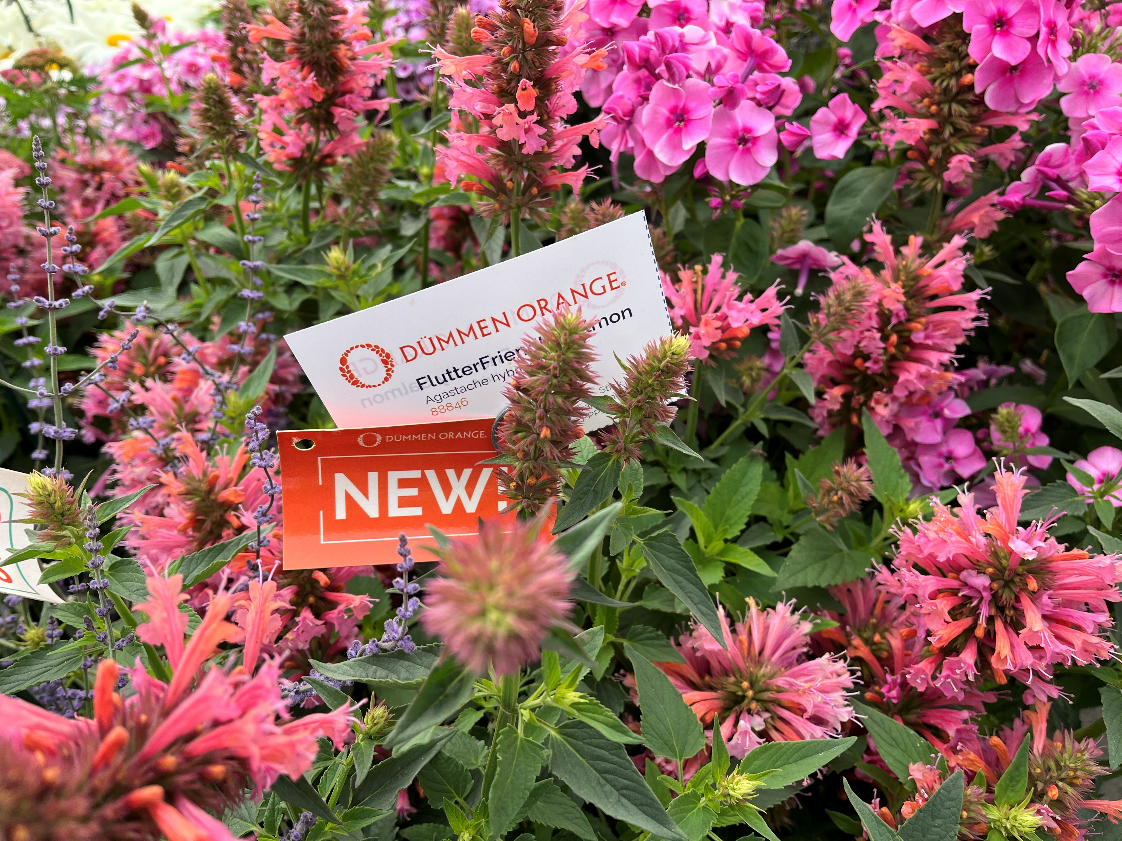
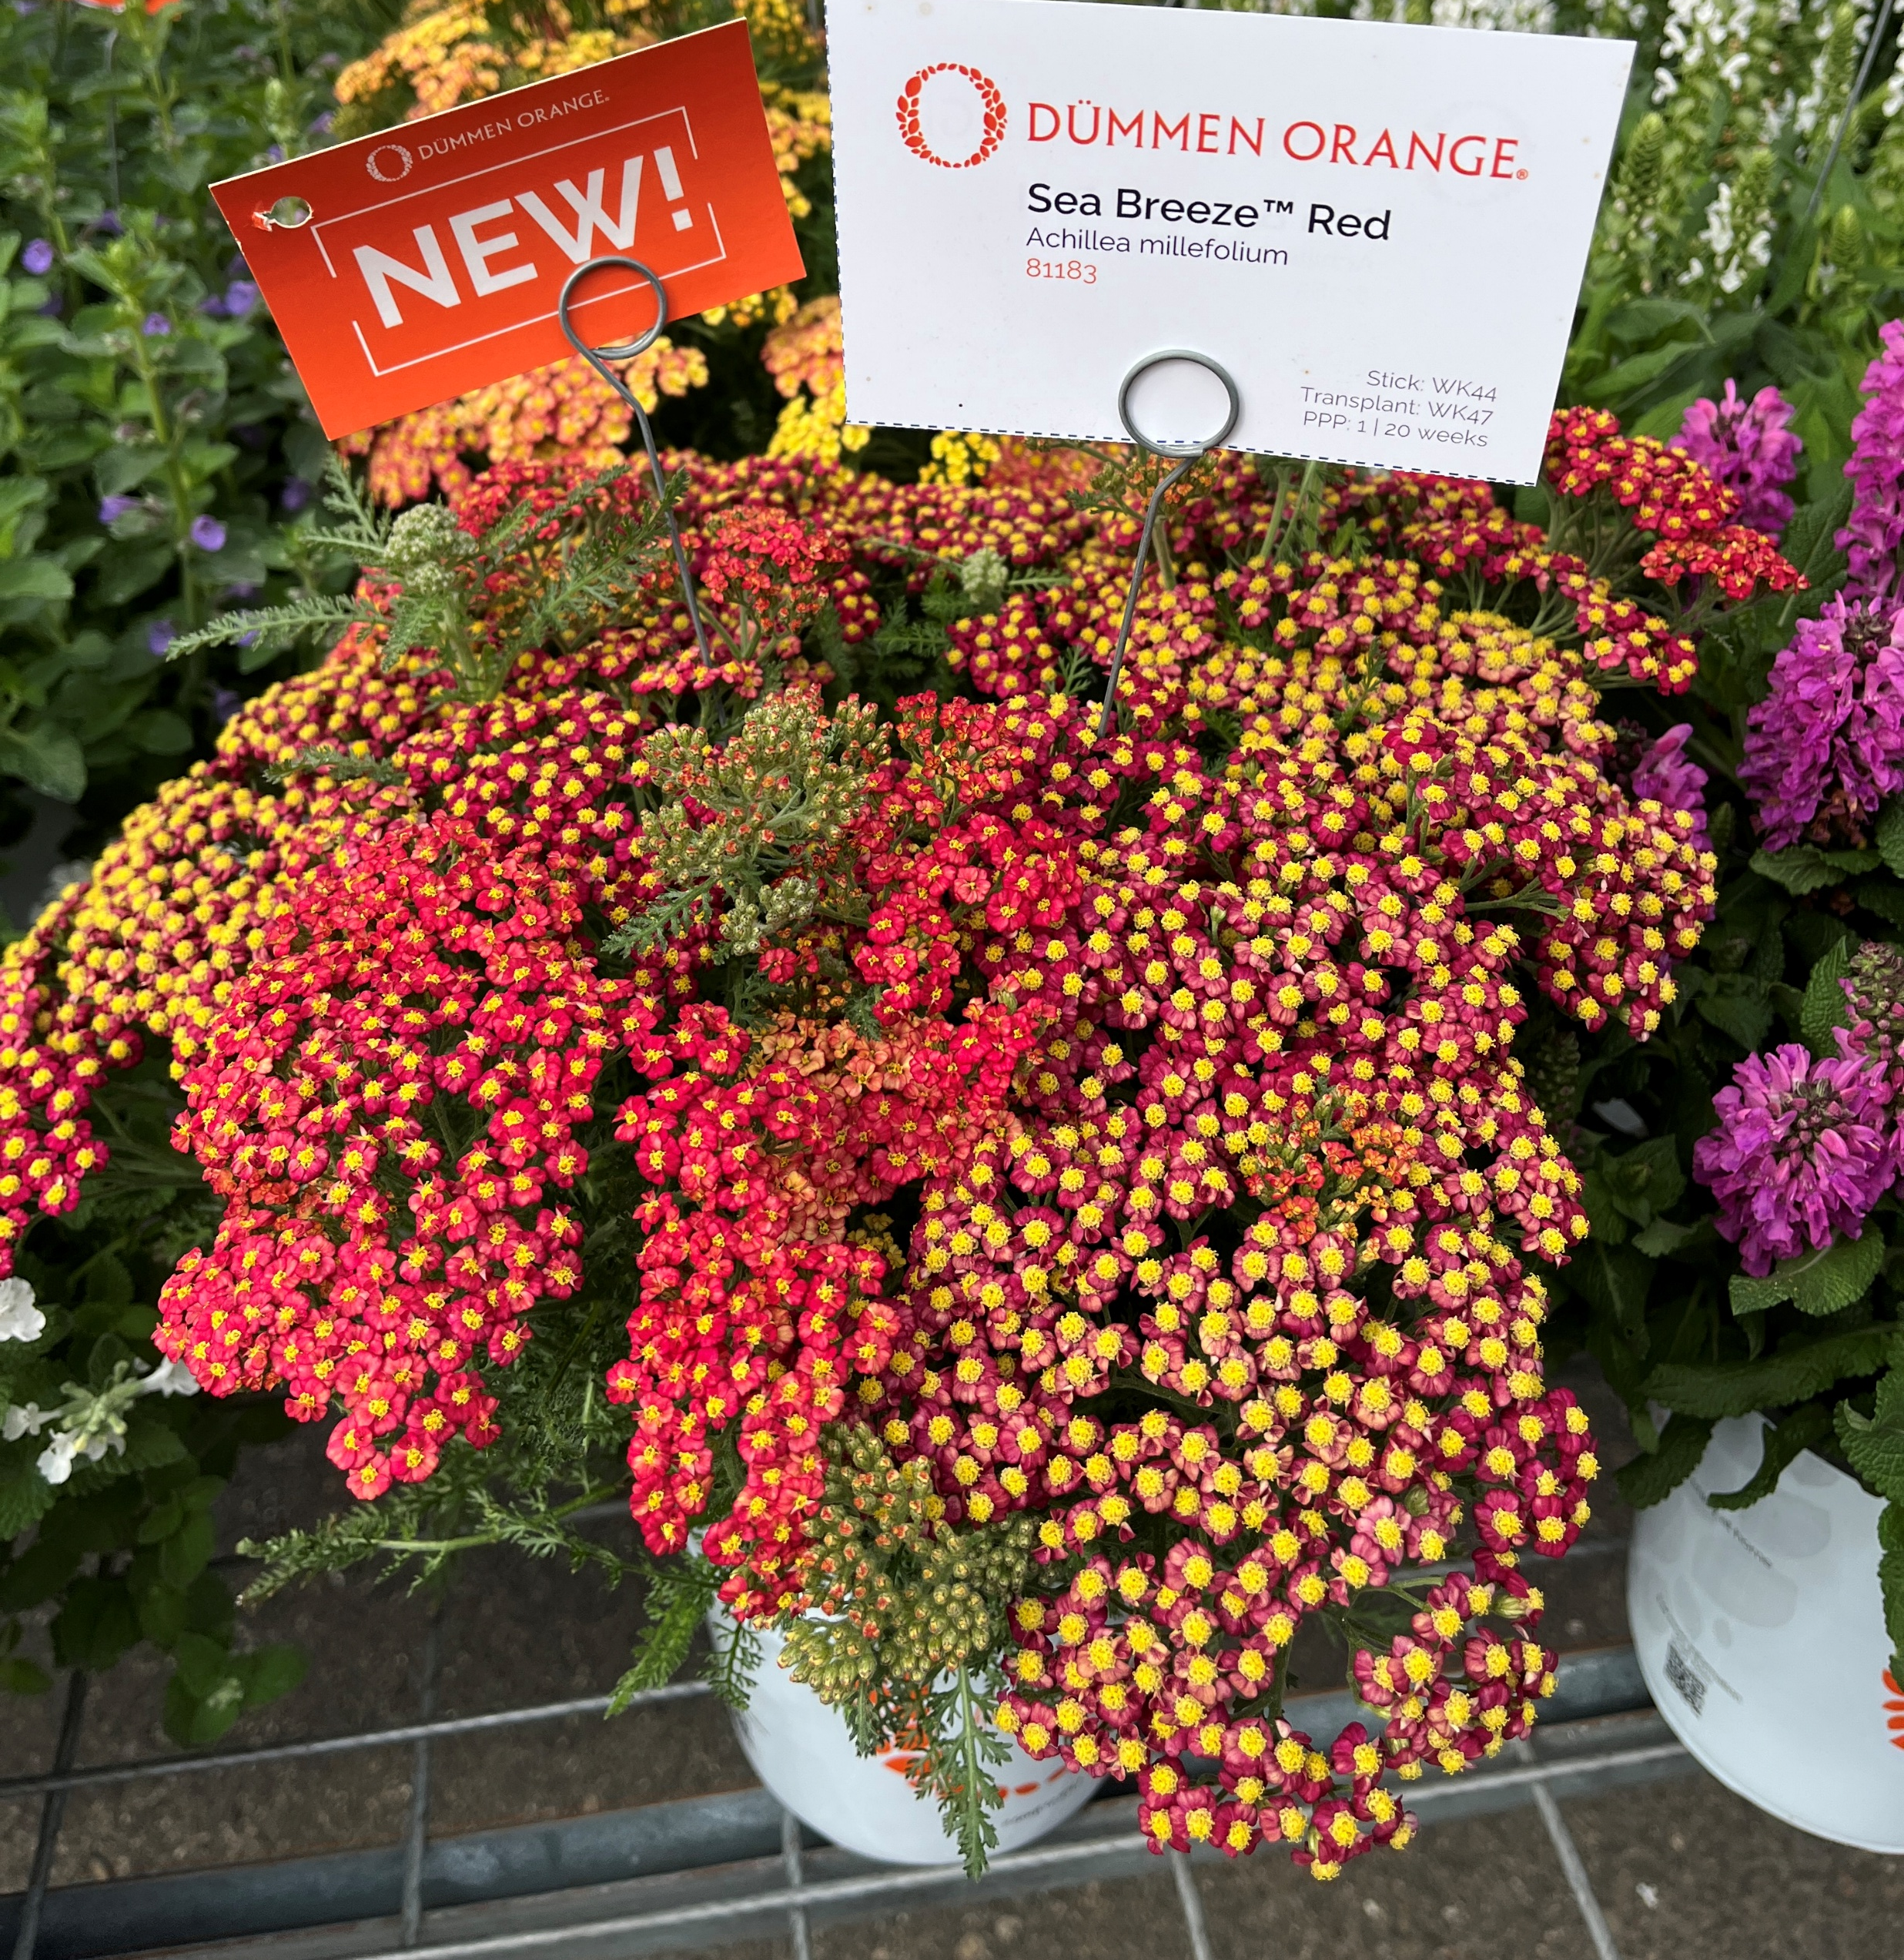
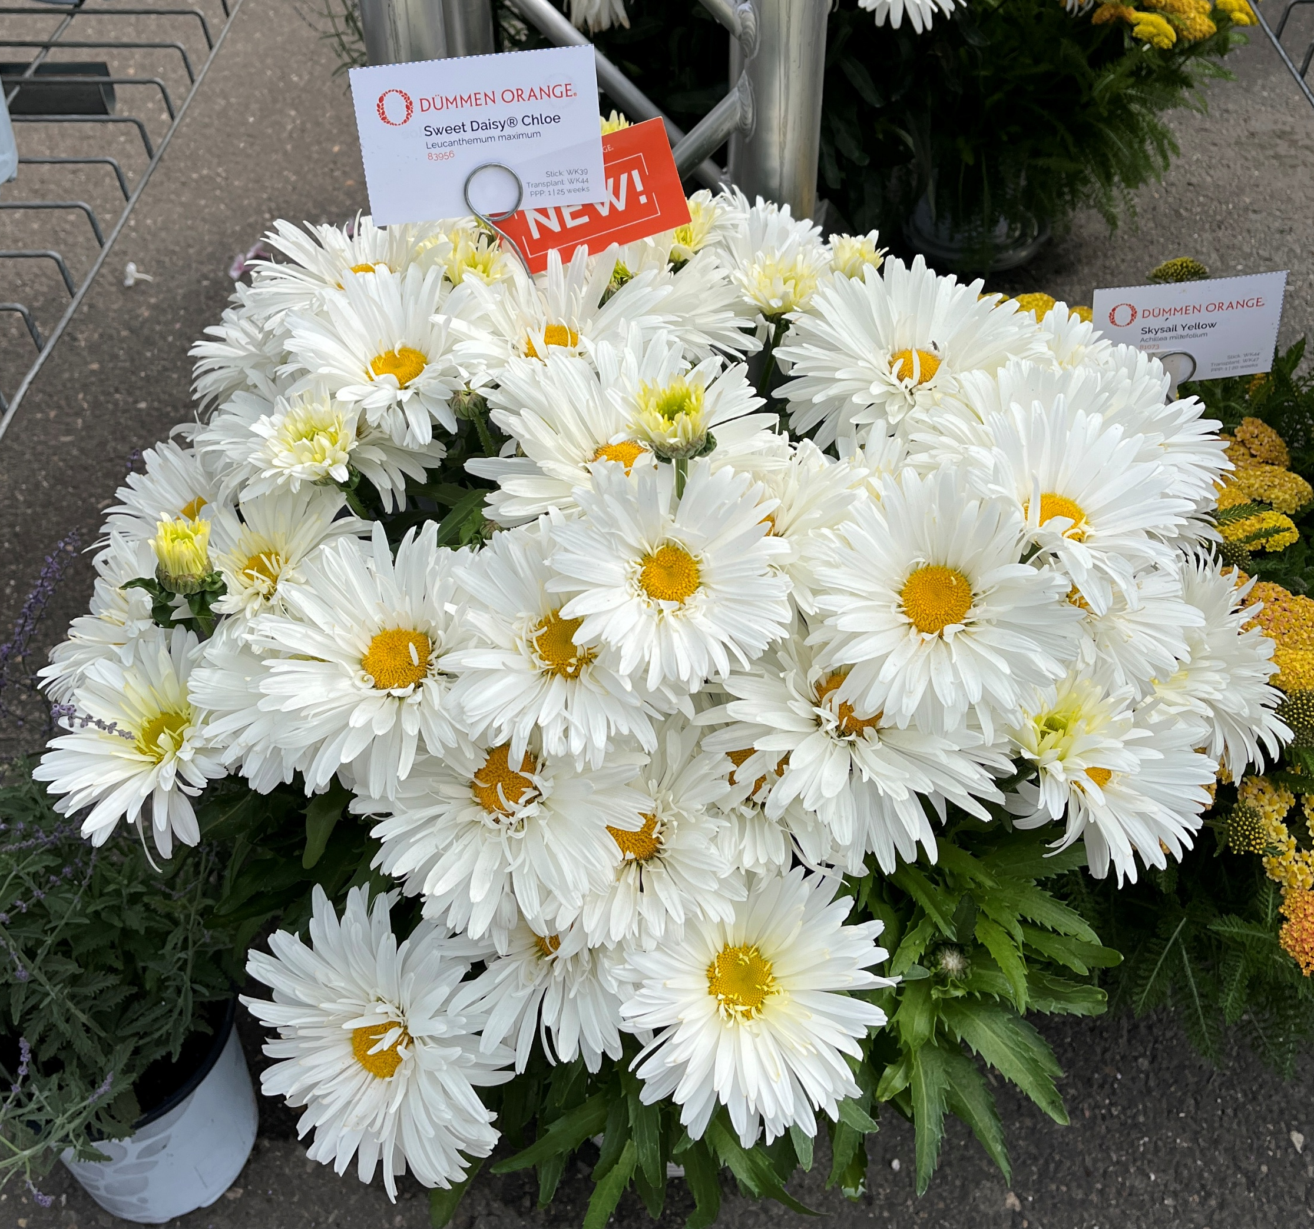
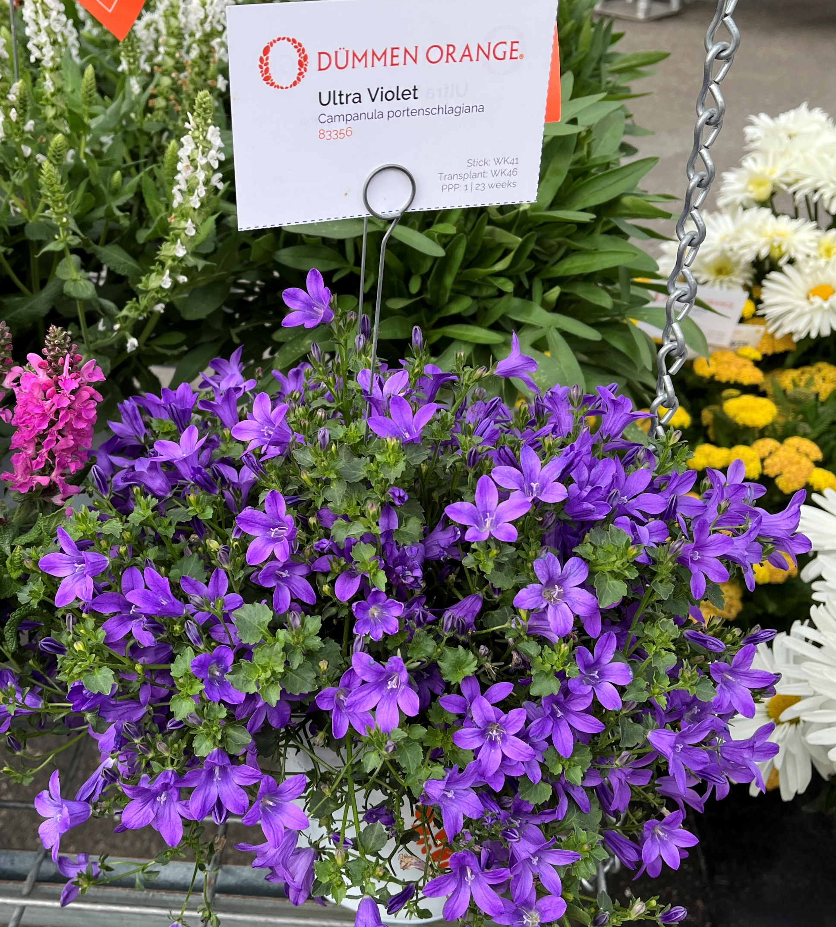
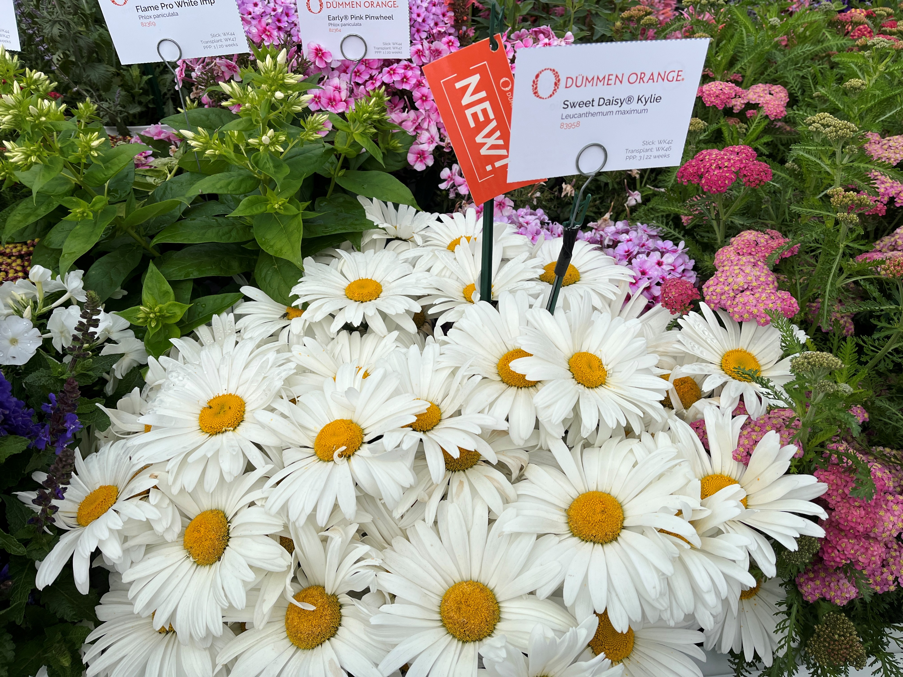
First Year Flowering Perennials
New Varieties/Series include:
Agastache FlutterFriendly series – Salmon, Orange, Red
Leucanthemum Sweet Daisy® Kylie and Chloe
Achillea Sea Breeze™ series – Red, Salmon
Salvia nemorosa Clarity (white), Noble Princess (magenta)
New genera
Sedum Cloudburst series
Nepeta Serene series
Campanula portenschlagiana Ultra Violet

Slide 14
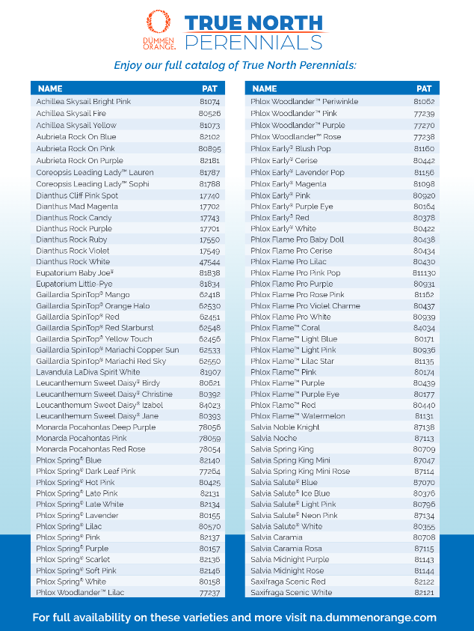
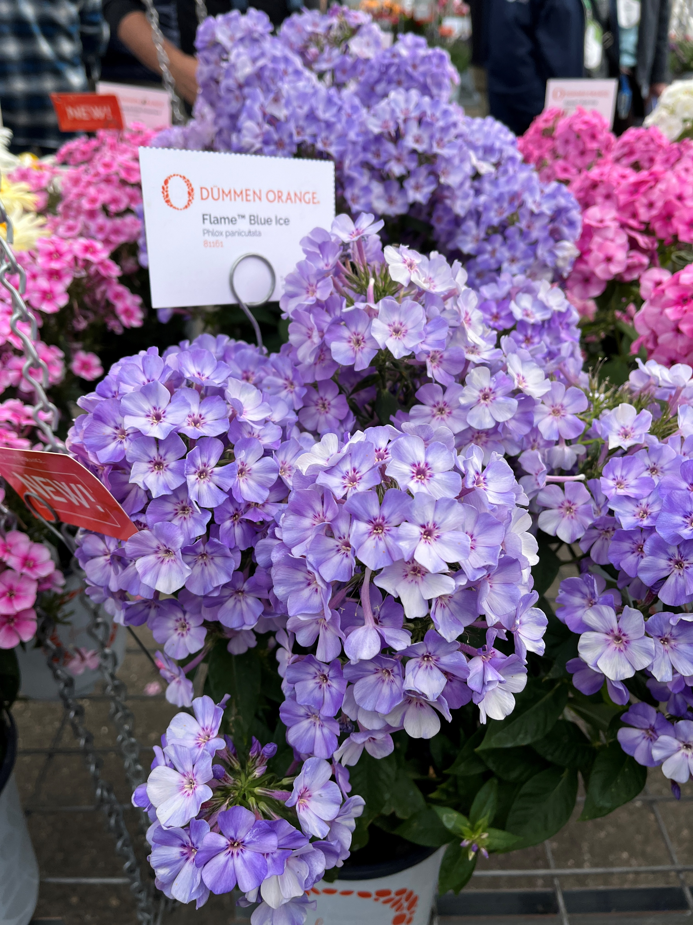
True North Perennials
Collection of perennials that have been trialed in Winnipeg, Canada (temps can reach -40F) Has to come back for 2 years to be selected.
Durable, tough plants are hardy to Zone 3
Resilient blooms that support pollinators even in the coldest climates
Sustainable drought tolerant once established, reducing the need for replacement
Top Picks include:
Leucanthemum Sweet® Daisy Birdy (AAS)
Dianthus Mad Magenta
Salvia Noble Knight

Slide 15

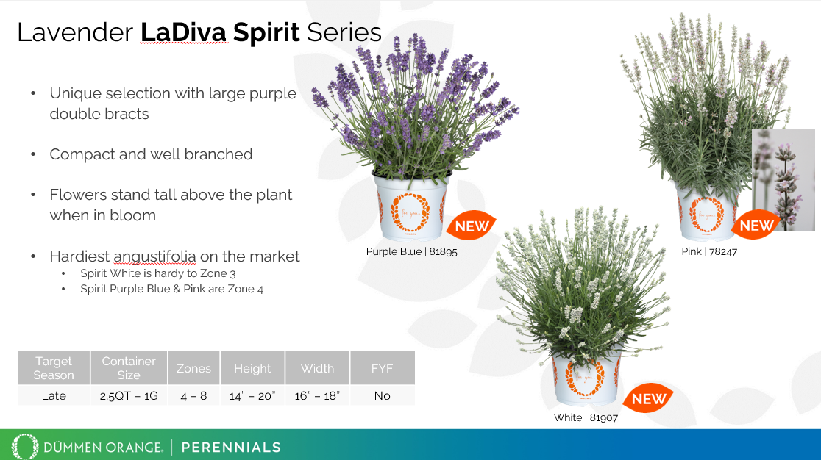
Lavender LaDiva Spirit Series
New angustifolia series Spirit
3 colors
Hardiest series of lavender in the market – Purple Blue & Pink are cold hardy to Zone 4, White is hardy to Zone 3 – surviving two winters and returning
Not First year flowering – these require vernalization
Large flowers stand above a compact mound of silver foliage
Unique pink and white selections
Perfect addition to the summer lavender program
Grow in 2.5 qt, gallon or make a duo or trio in a large deco pot
Dummen is offering La Diva callus cuttings at the unrooted price.
You can reduce overall rooting time by 2 weeks using callused cuttings.
URC rooting time 6 -8 weeks
CC rooting time 4 – 6 weeks
Transplant to finish for 1 gallon 12-14 weeks

Slide 16
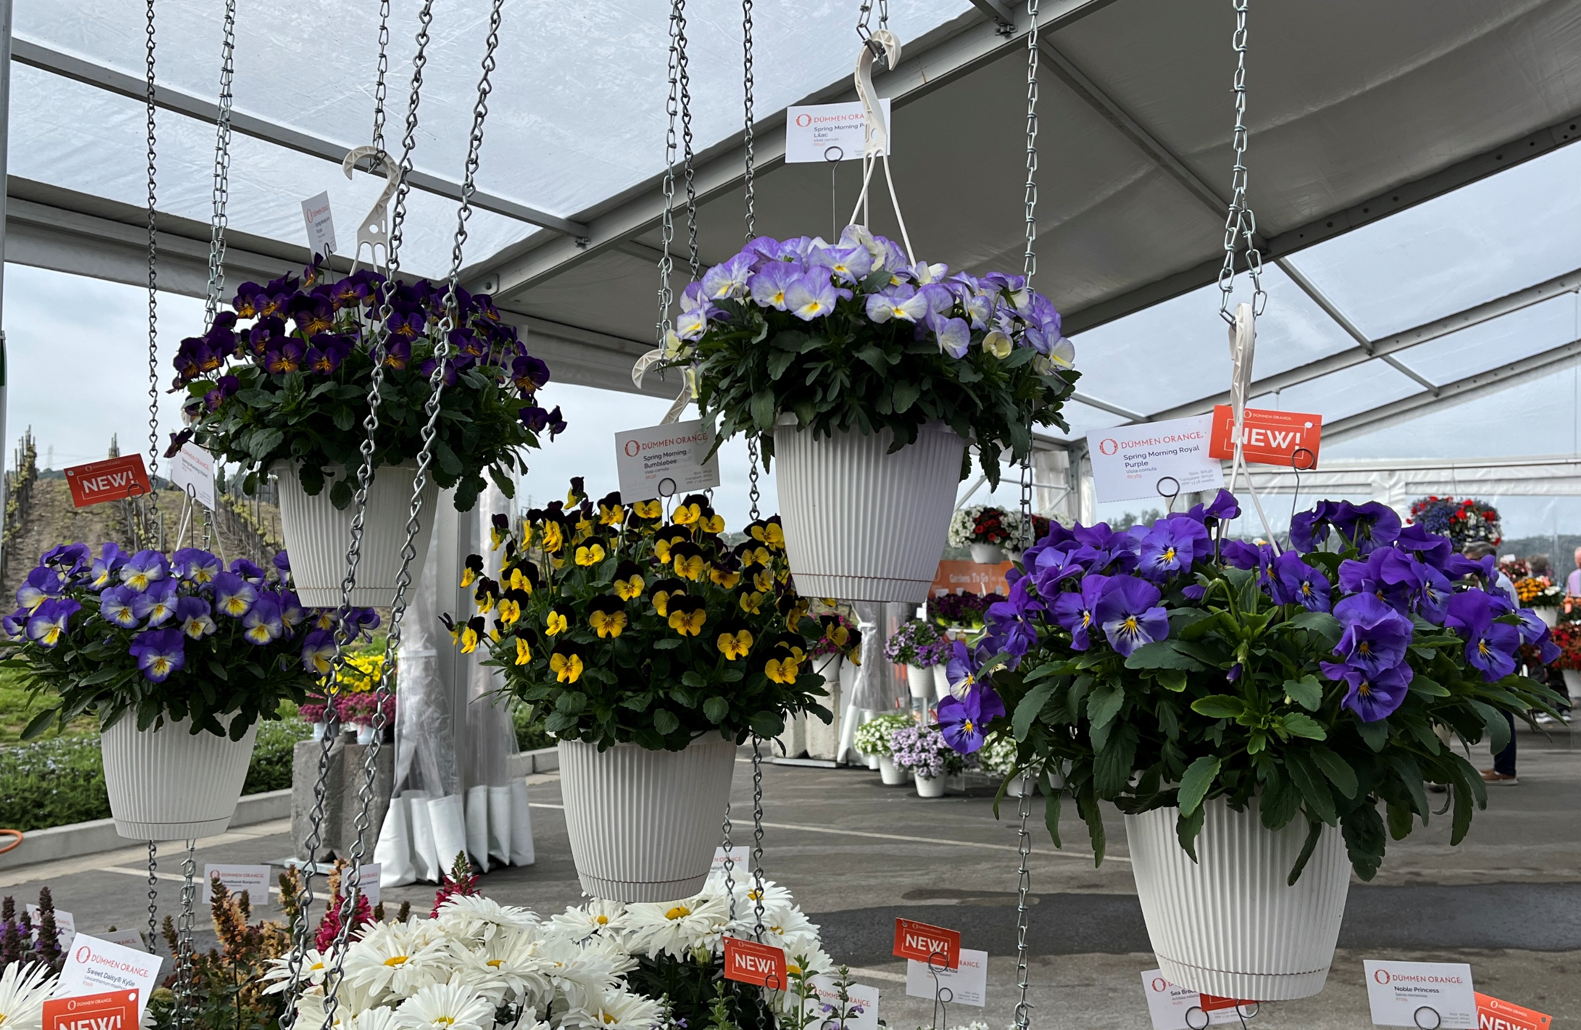
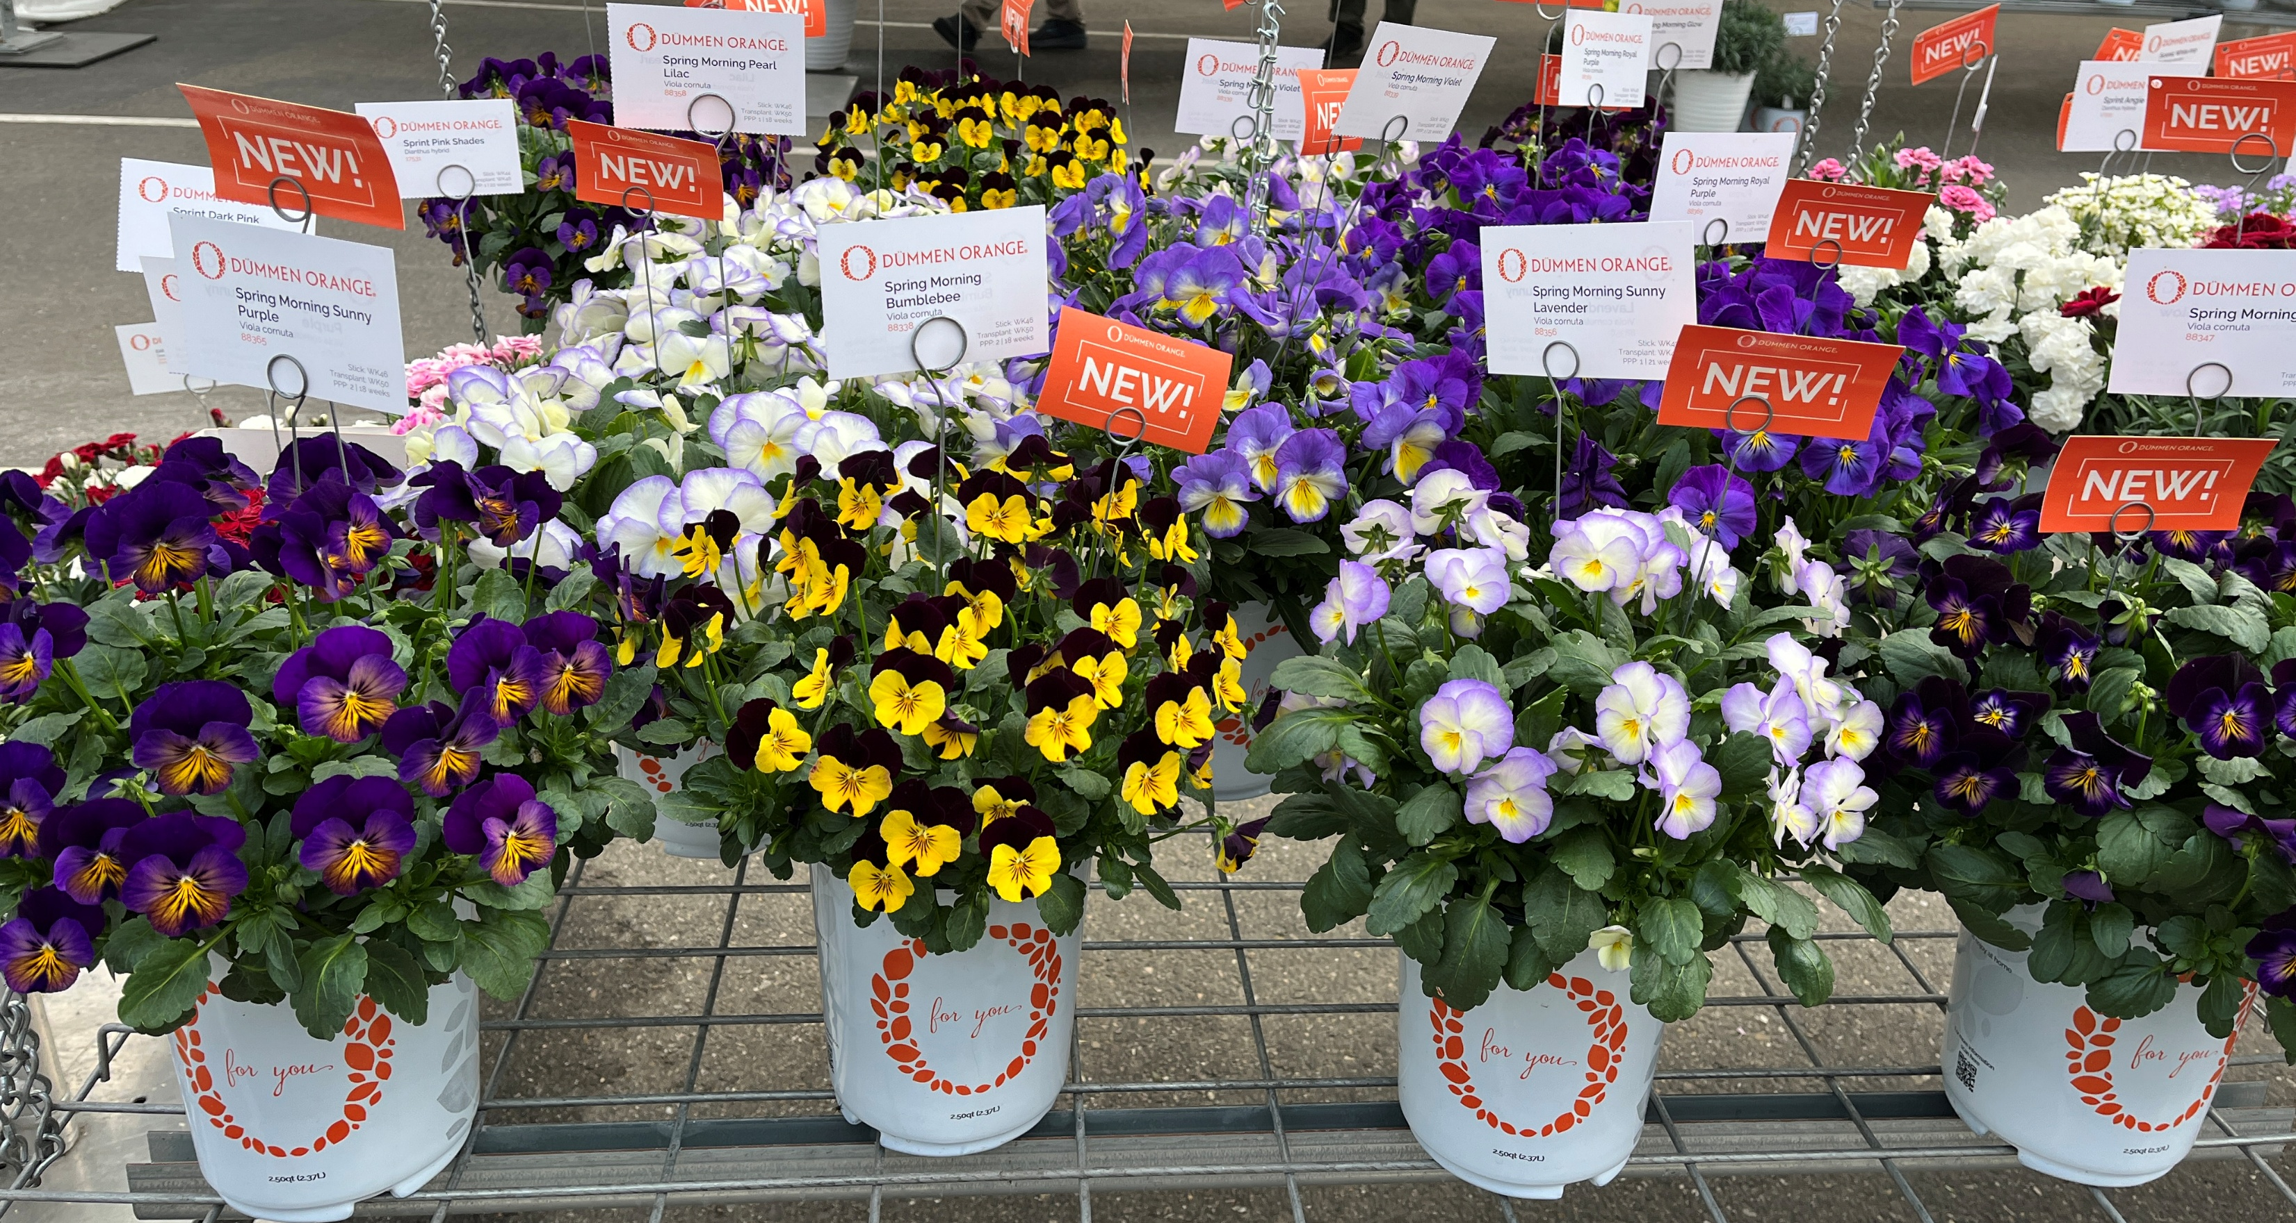
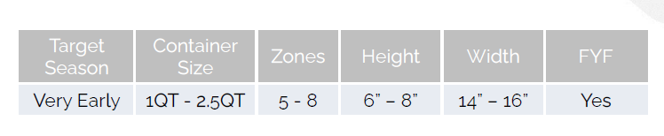
Viola Spring Morning – New Series
Part of the Early Season Perennials group, able to withstand unpredictable early-season conditions
Spring Morning has 7 colors
Bumblebee, Glow, Pearl Lilac, Royal Purple, Sunny Lilac, Sunny Purple, Violet
First year flowering
Full Sun – Part Shade
Heat tolerant
A true perennial viola, Zones 5 – 8
Recommended pot size 1 QT – 1 Gal

